Slide 1

BCPR 283 Assignment 1 Part B
Presented by: Zilin Li (Student ID: 99172142)

Slide 2
Deliverables Part A
Feature 1: Load game form CSV
Feature 2: Time the game
Feature 3: Do not accept an invalid number
Feature 4: Show if a row is complete
Feature 5: Show if a Column is complete
Feature 6: Show if a square is complete
Feature 7: Do not override a default value
Feature 8: Show game complete

Slide 3
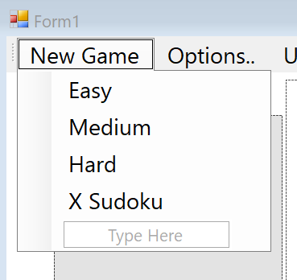
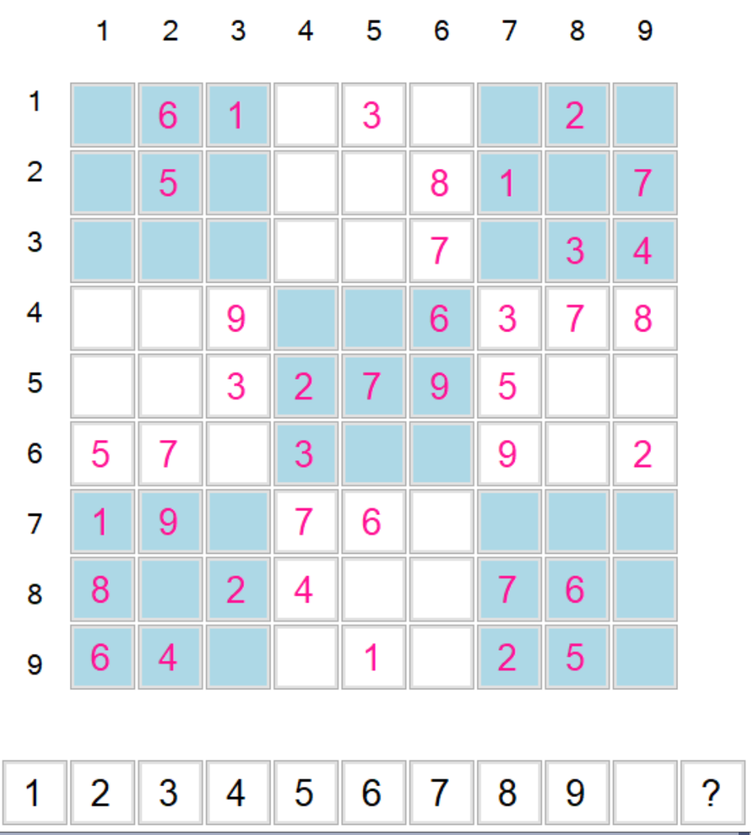
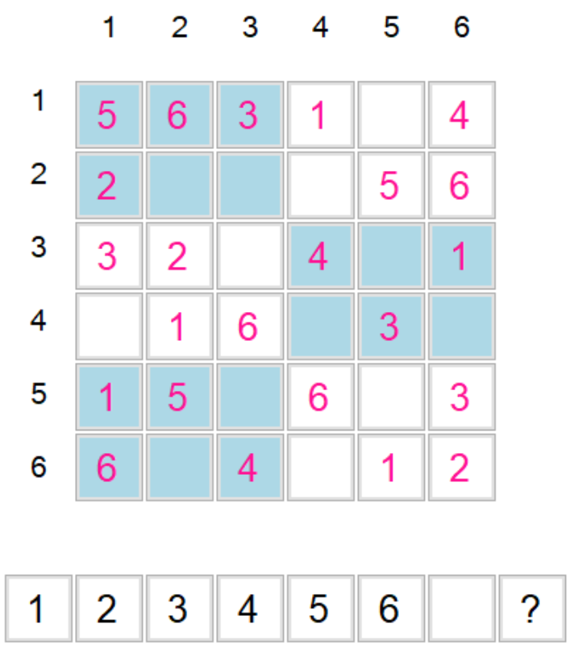
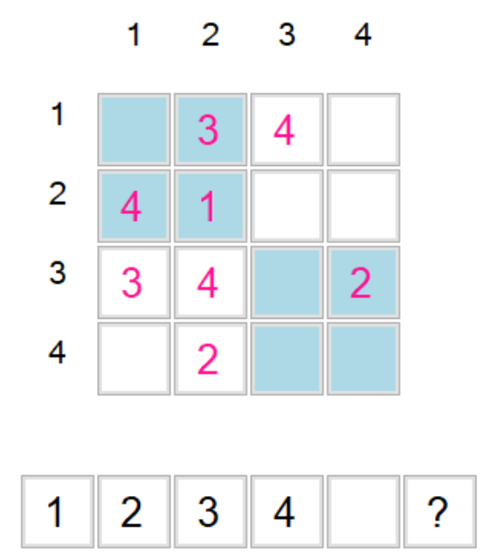
Feature 1: Load game form CSV
1. There are Four game modes for the user to choose.
Hard :
Medium :
Easy:

Slide 4
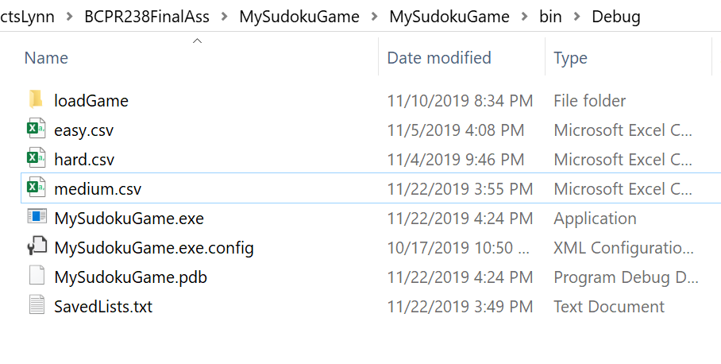
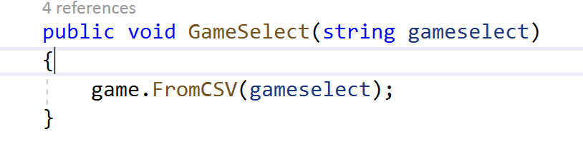
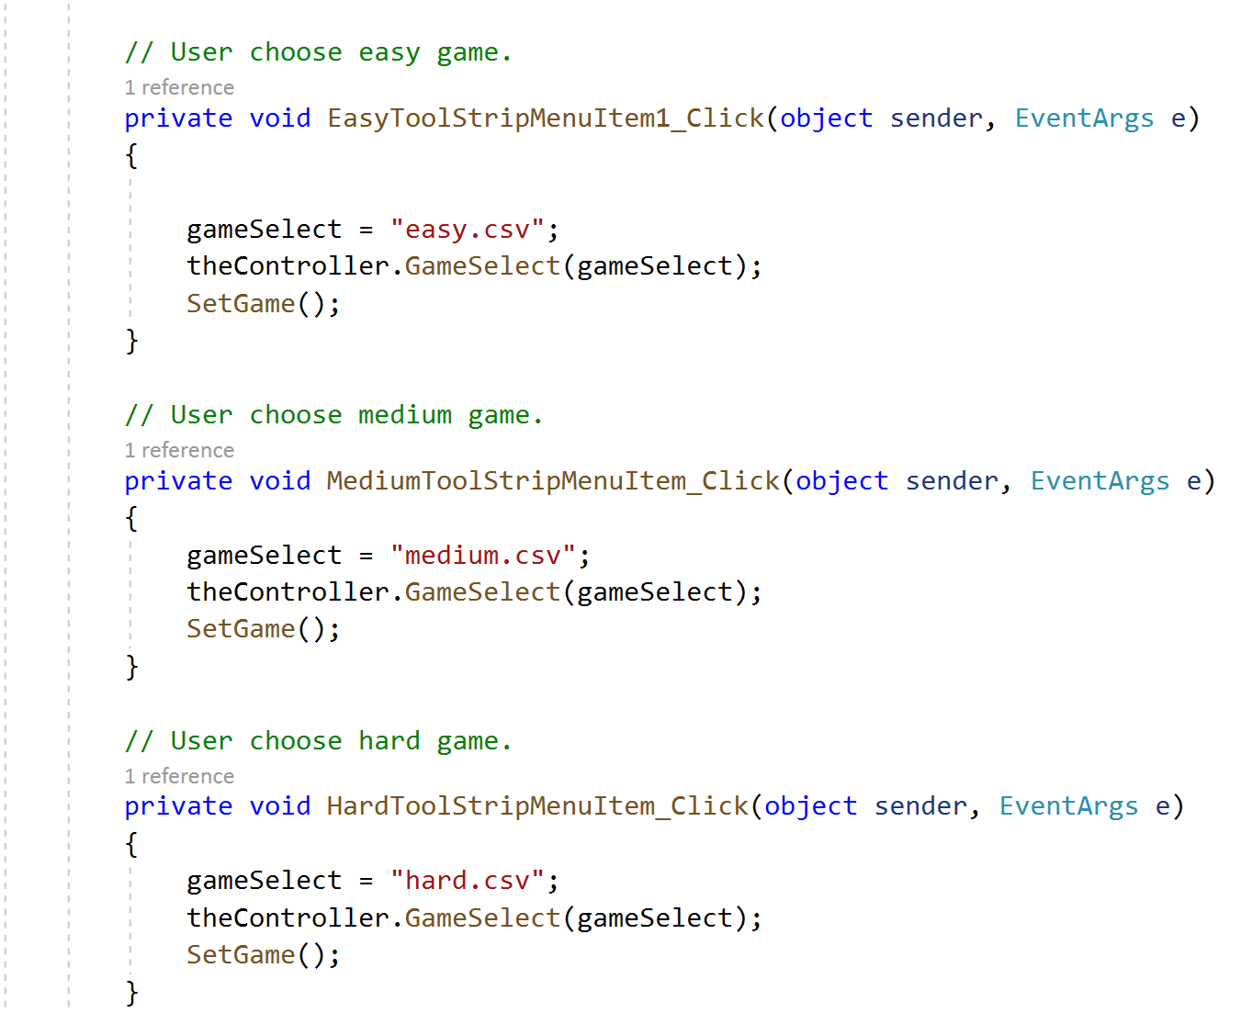
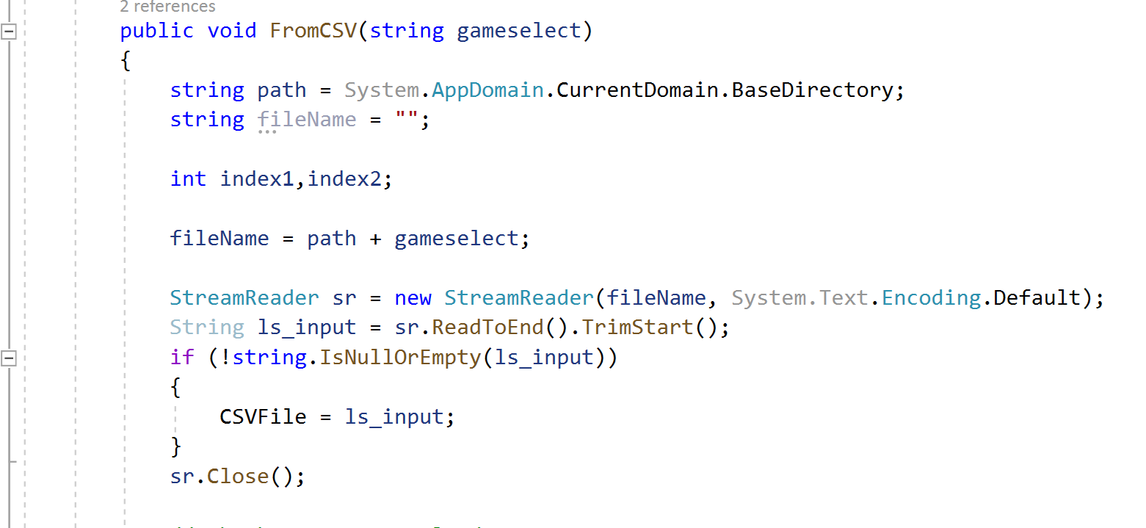
Feature 1: Load game form CSV
2. The game load from CSV file.
Controller:
FormMain:
Model:

Slide 5
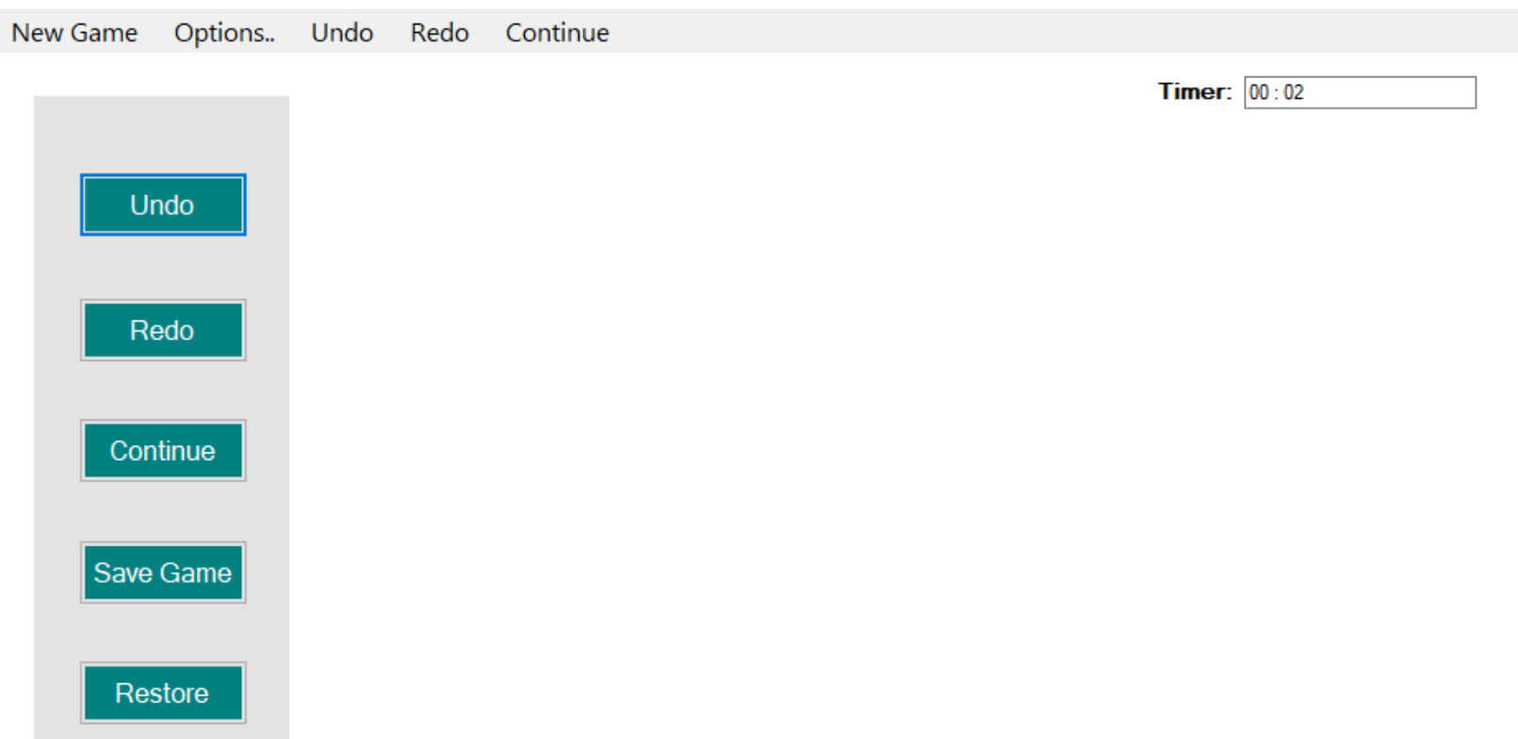
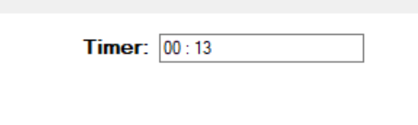
Feature 2: Time the game
1. I designed a game timer.
2. When a new game starts, the game loads, and the game restarts, the timer start counting.
3. When the game pause button is clicked, the timer stops and the game board is hidden. The text of the pause button becomes "continue".
4. When clicking the continue button, the game page reappears, the timer continues in a timely manner, and the key text becomes "pause".

Slide 6
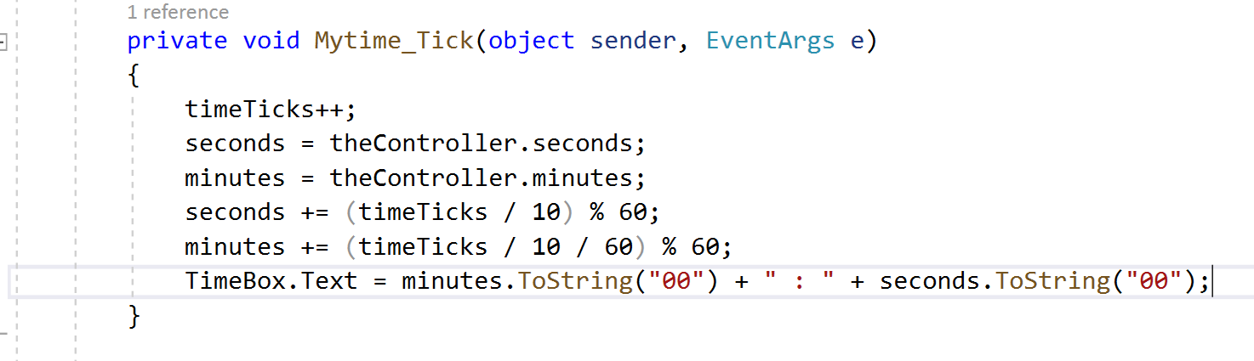
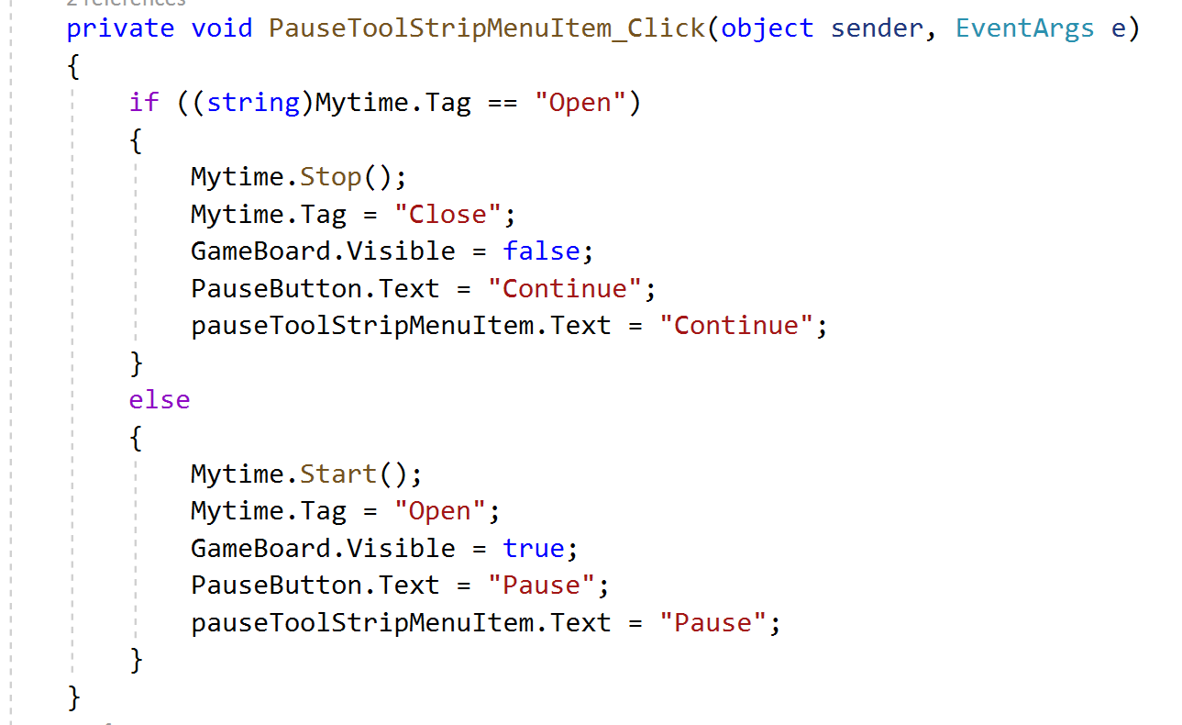
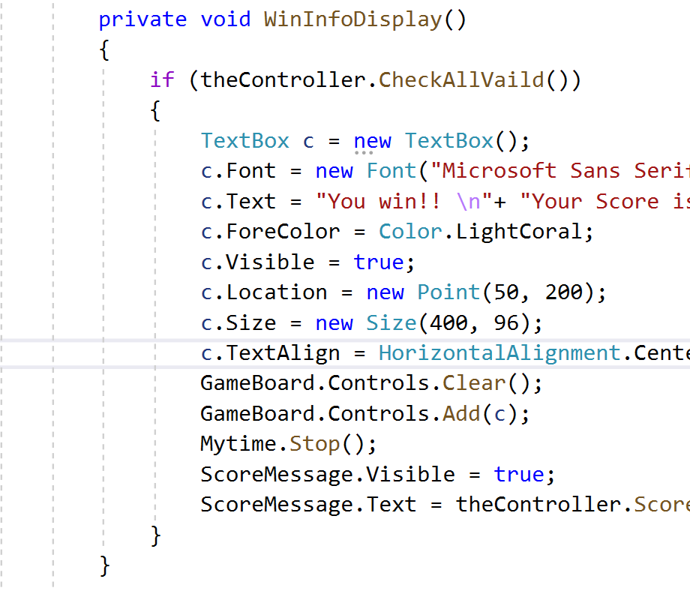
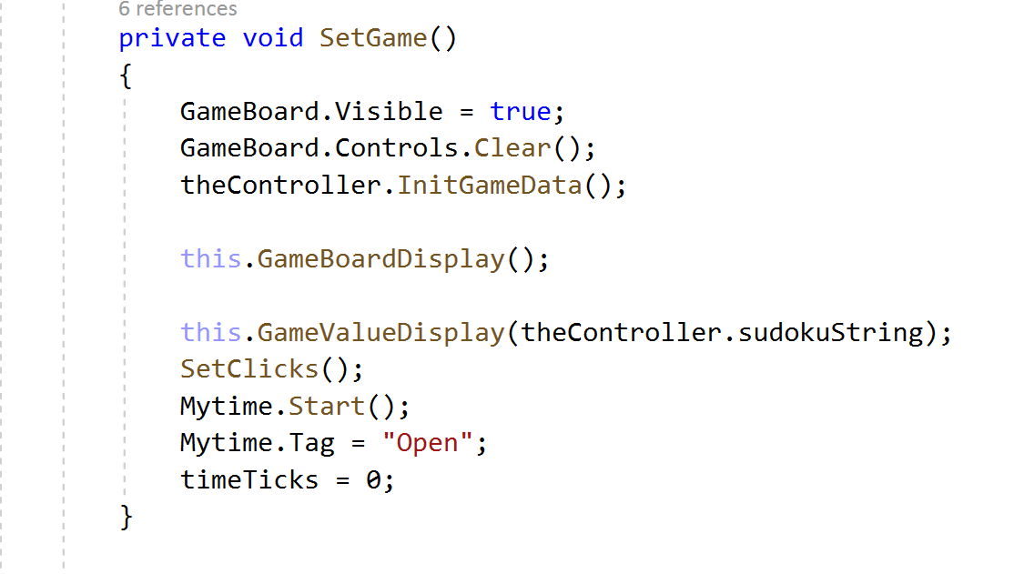
Feature 2: Time the game
Create a timer:
Pause and Continue:
Timer stop when game finished:
Set timer start when new game load:

Slide 7
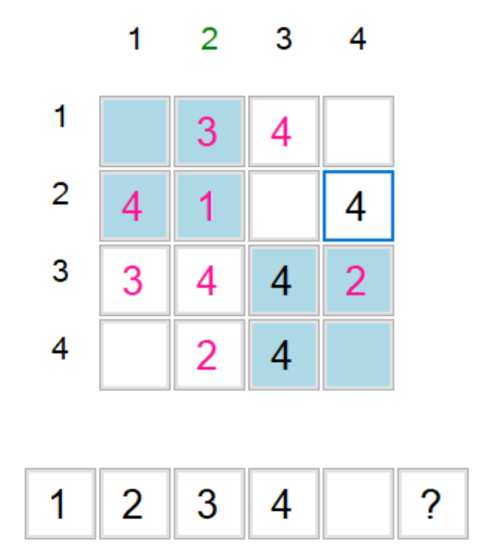
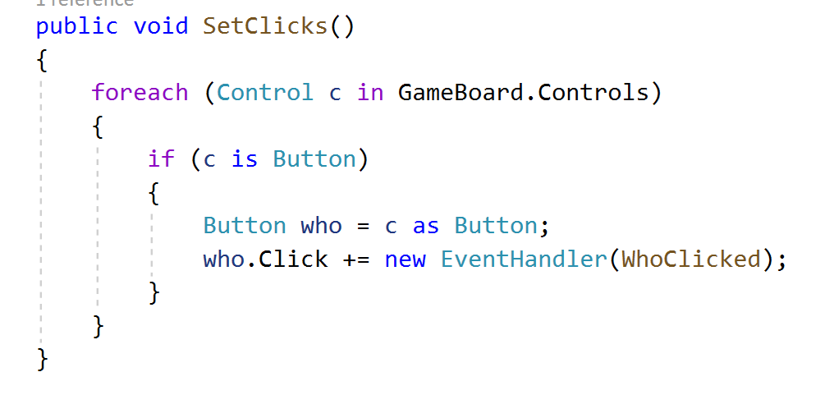
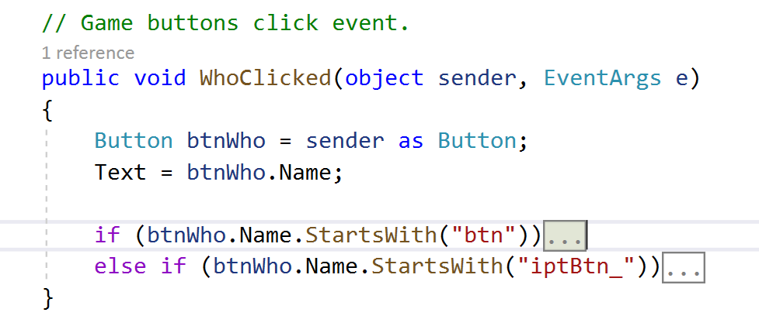
Feature 3: Do not accept an invalid number
I use buttons to design the layout of sudoku games, so it is impossible for users to enter invalid Numbers.
FormMain:
This button use to empty the value.
FormMain:
This button use to give user hint.
User choose number from the number board.

Slide 8
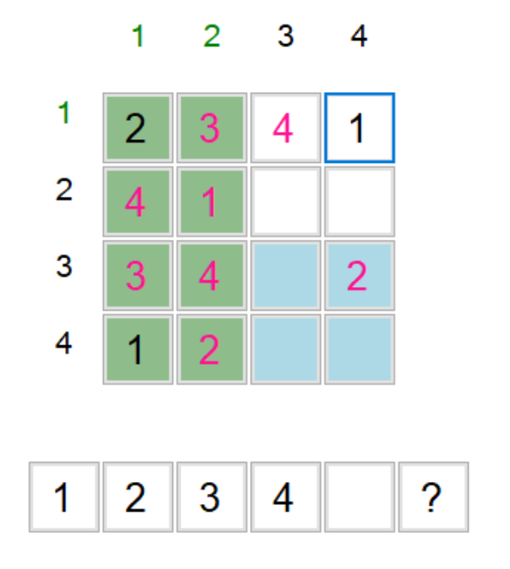
Feature 4 & Feature 5 & Feature 6： Show if a row or column or square is complete
I designed row and column labels on the left and top of the board. Each time the user changes values, the background program determines which rows, columns, and squares are complete. Complete information about rows and columns is displayed by row and column labels, and complete information about squares is displayed by changing the background color of squares.
When column is complete ,the column labels color turn green.
When row is complete ,the row labels color turn green.
When square is complete ,the square’s background color turn green.

Slide 9
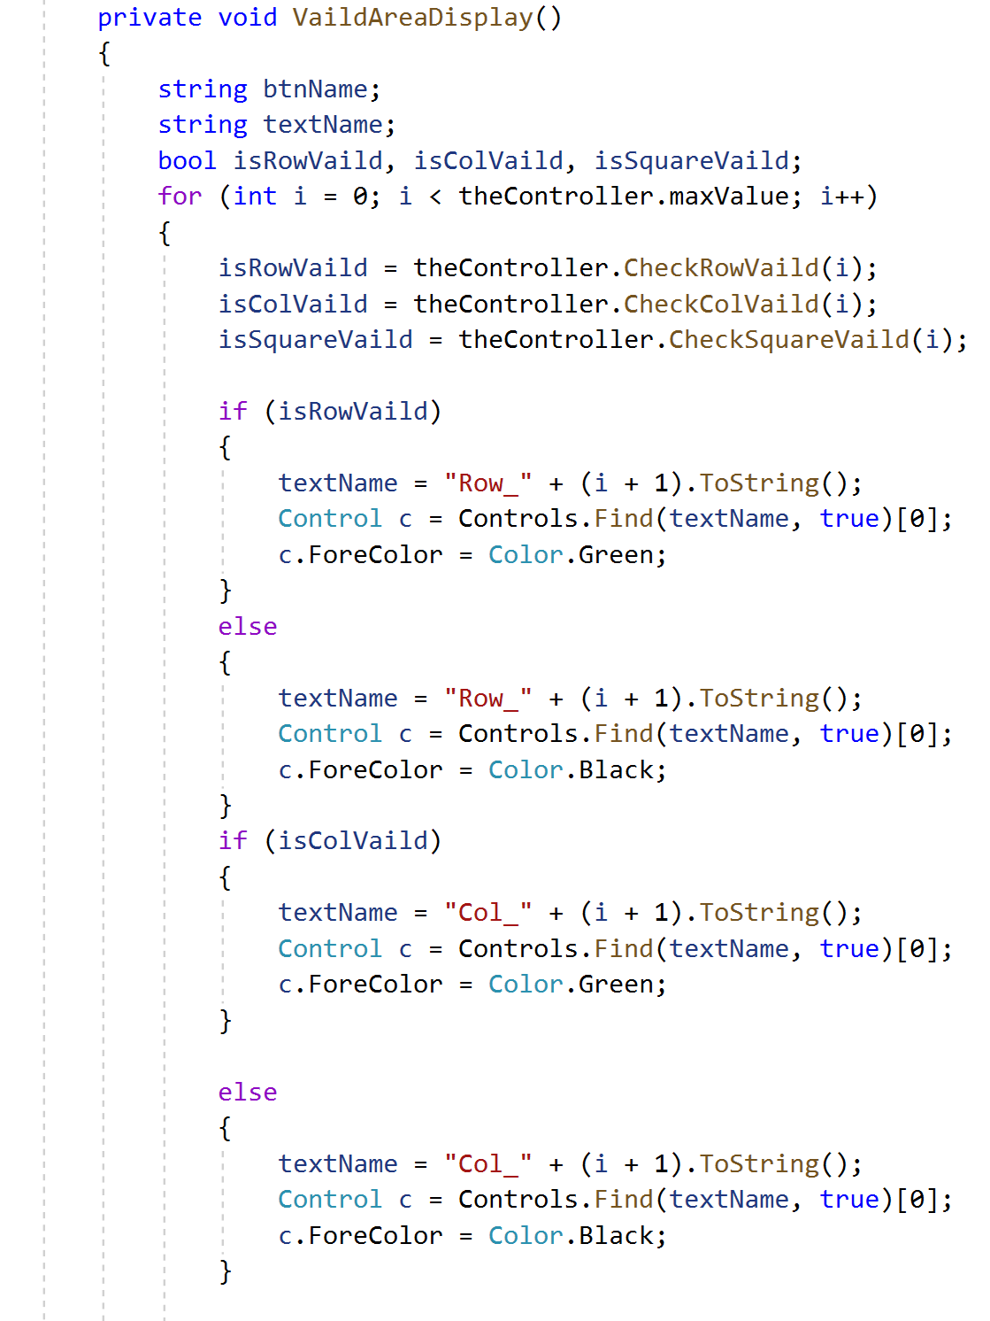
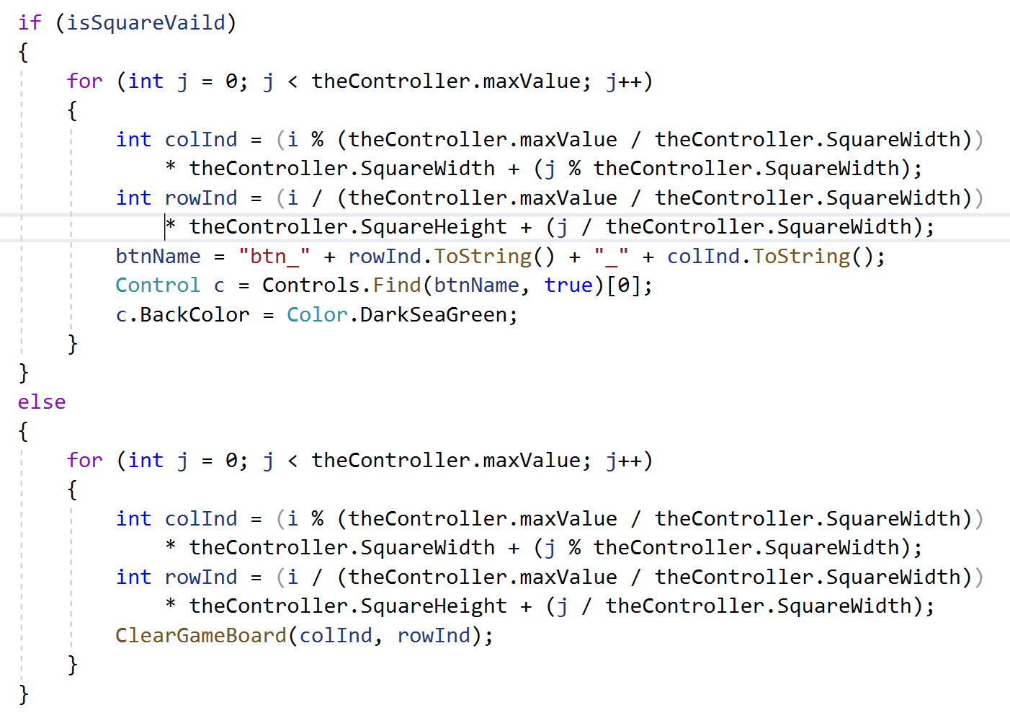
Feature 4 & Feature 5 & Feature 6： Show if a row or column or square is complete
Code example from FormMain:
This part accepts the data information passed by the model and determines whether the row,column, square is completed.
These three sections are used for page display.

Slide 10
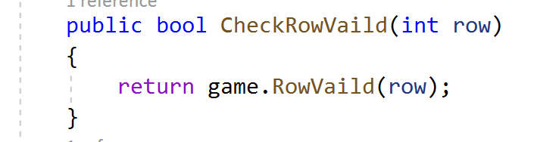
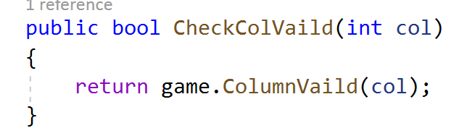
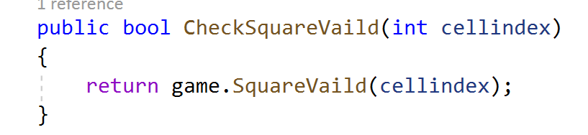
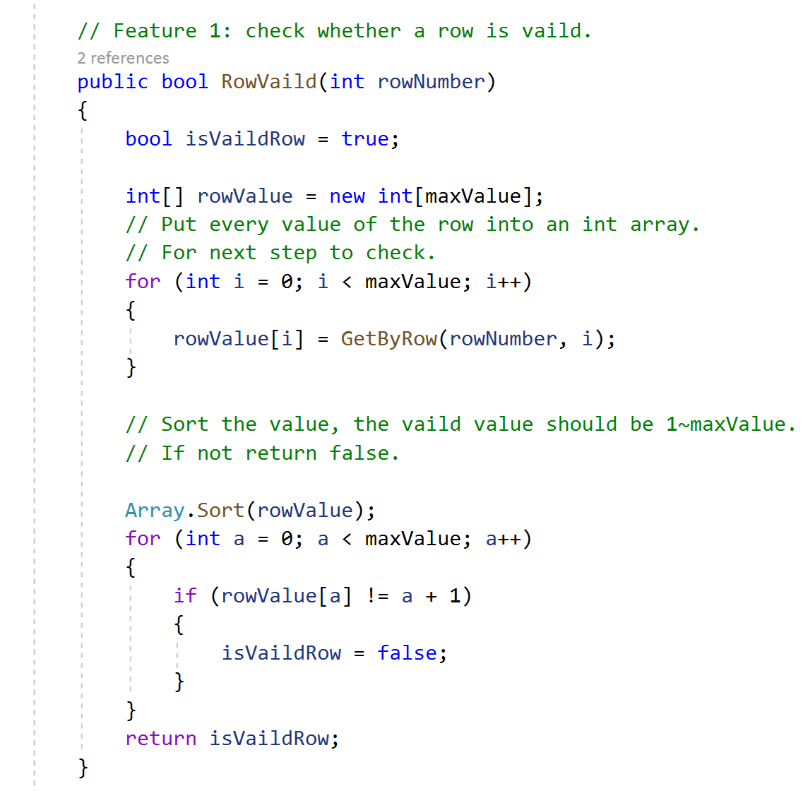
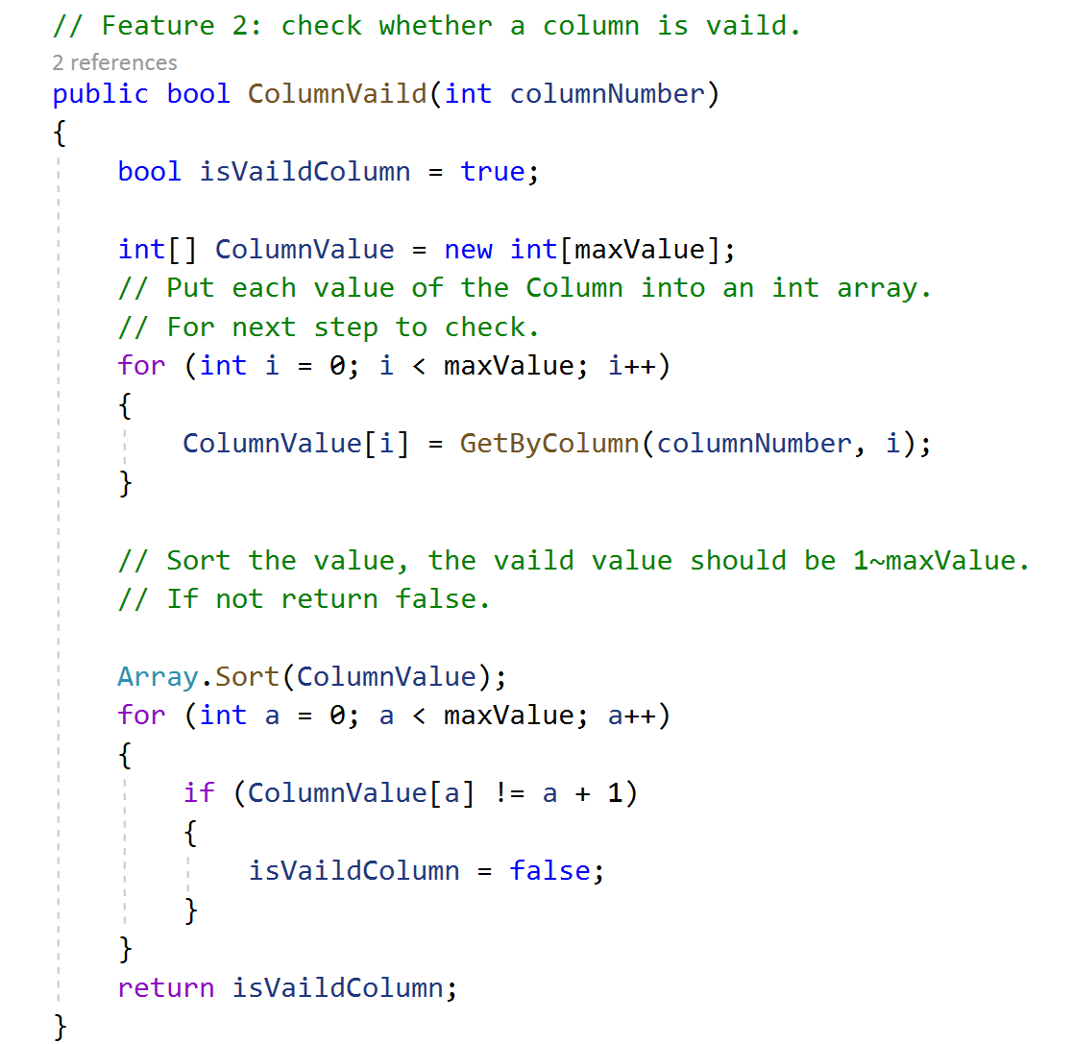
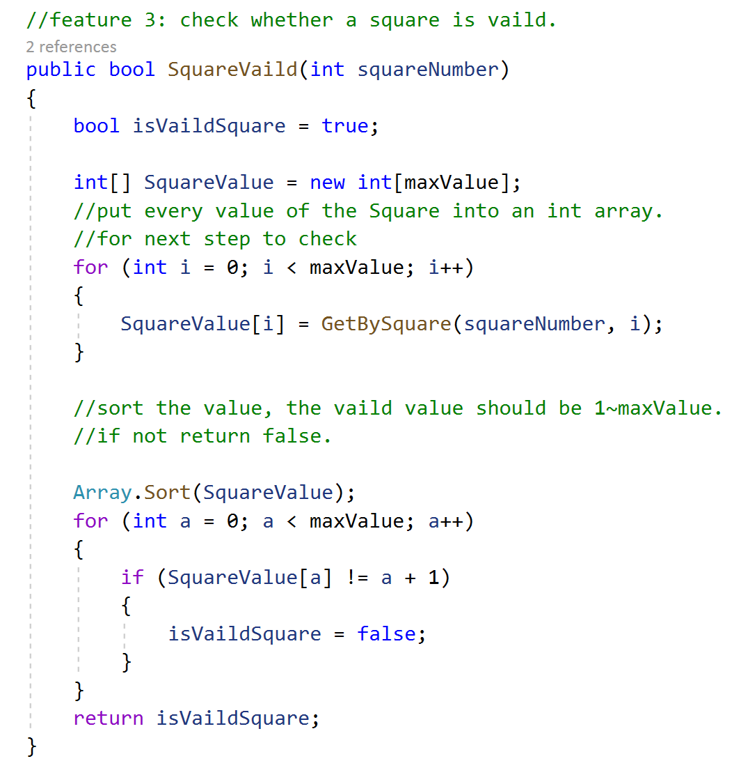
Feature 4 & Feature 5 & Feature 6： Show if a row or column or square is complete
Code example from Controller:
Code example from Model:

Slide 11
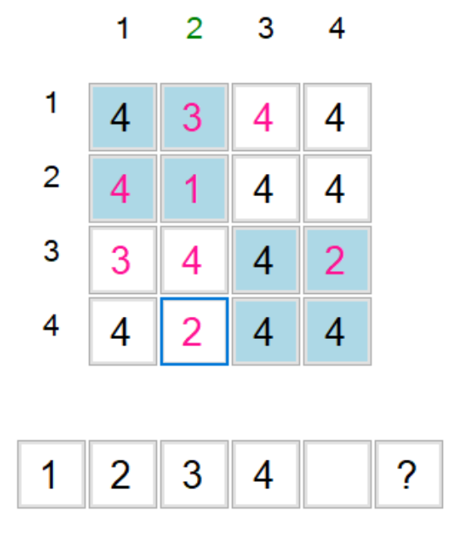
Feature 7: Do not override a default value
The default value of the game cannot be changed.
When the game is loaded, the loaded CSV document will be judged. If the content of the CSV document contains the game default value location(or call it index) information (this kind of CSV document is used to store the game have been played by the user, the game will automatically save the default value location of the game when click the “save” button), the game will read the existing default value in the CSV.
If the CSV document does not contain the game default value location information (this kind of CSV document stores a new game), the program parses the document, finds out the game default value location and saves it.
The other numbers display in Black color, user can change the value.
The default numbers display in Pink color and can not be changed.

Slide 12
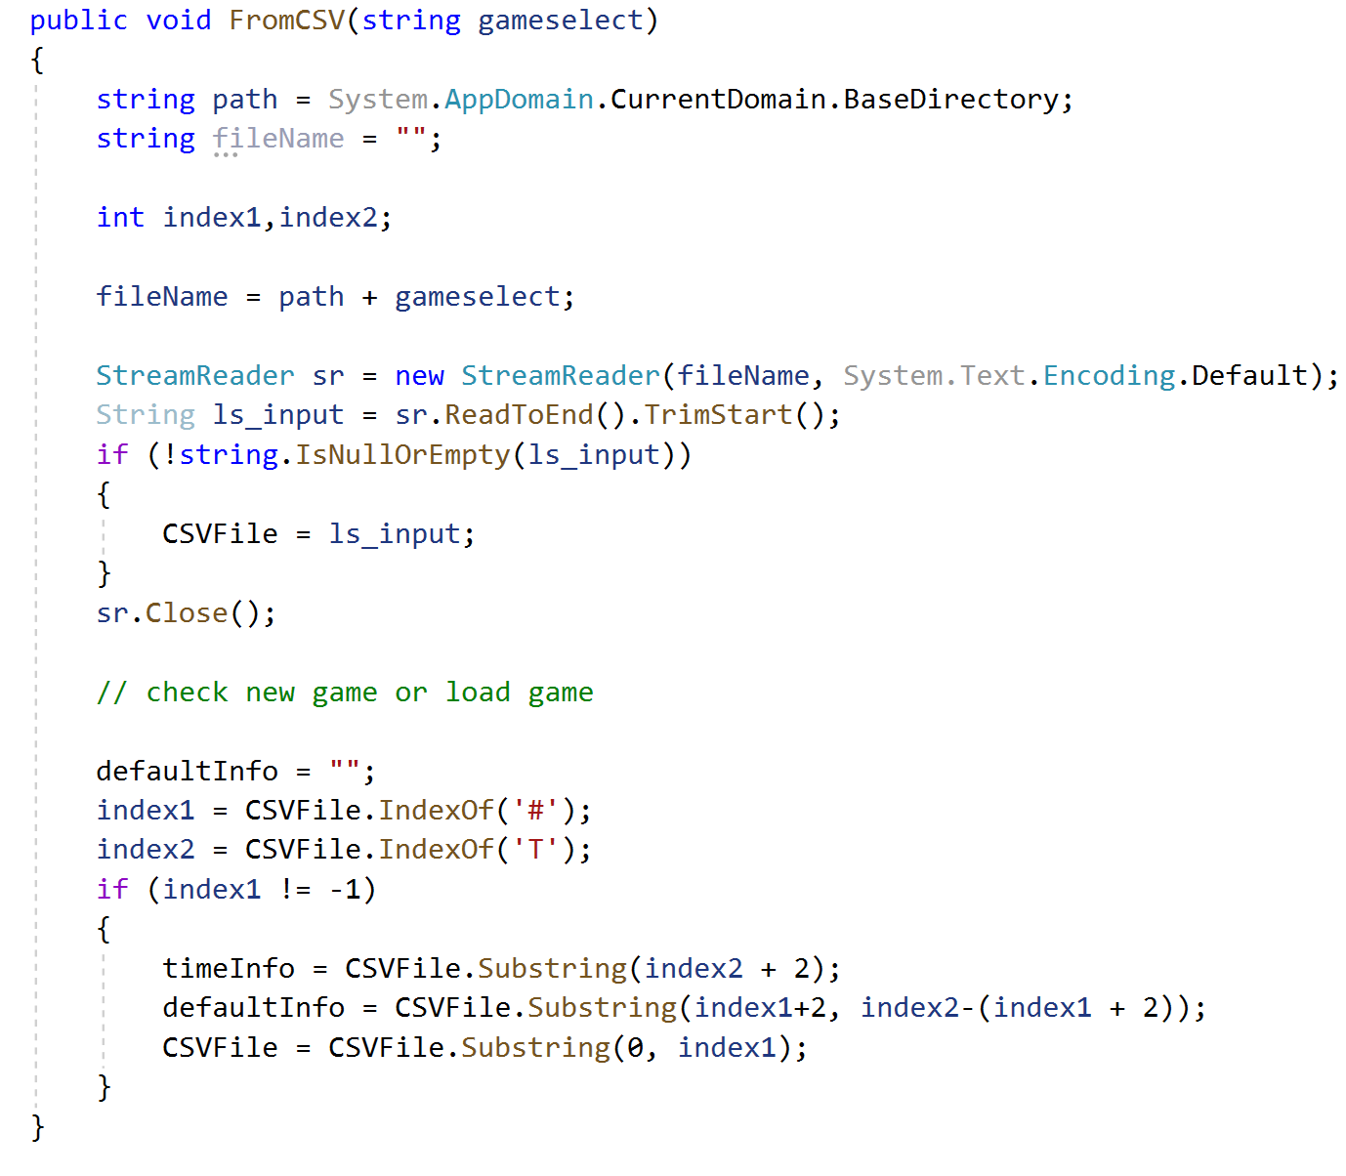
Feature 7: Do not override a default value
Code example from Model:
When reading documents, judge whether there is default value information. If there is default value location information, extract the information.
Default value location information is after “#”, before “T”.
String “defaultInfo” like a flag.

Slide 13
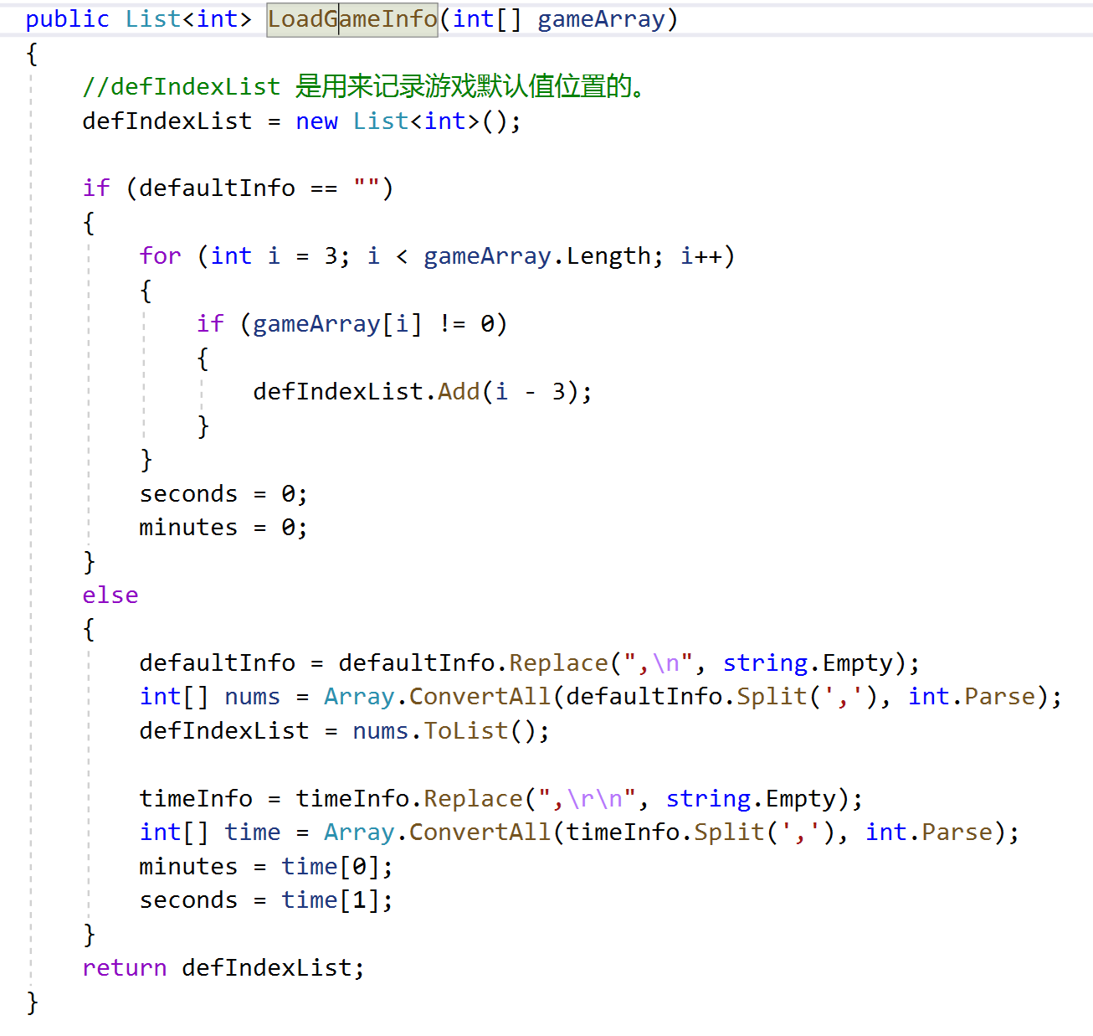
Feature 7: Do not override a default value
Code example from Model:
If there is no default value information in the document, find the location of the default value from the original data.
The situation of game default value information in CSV file

Slide 14
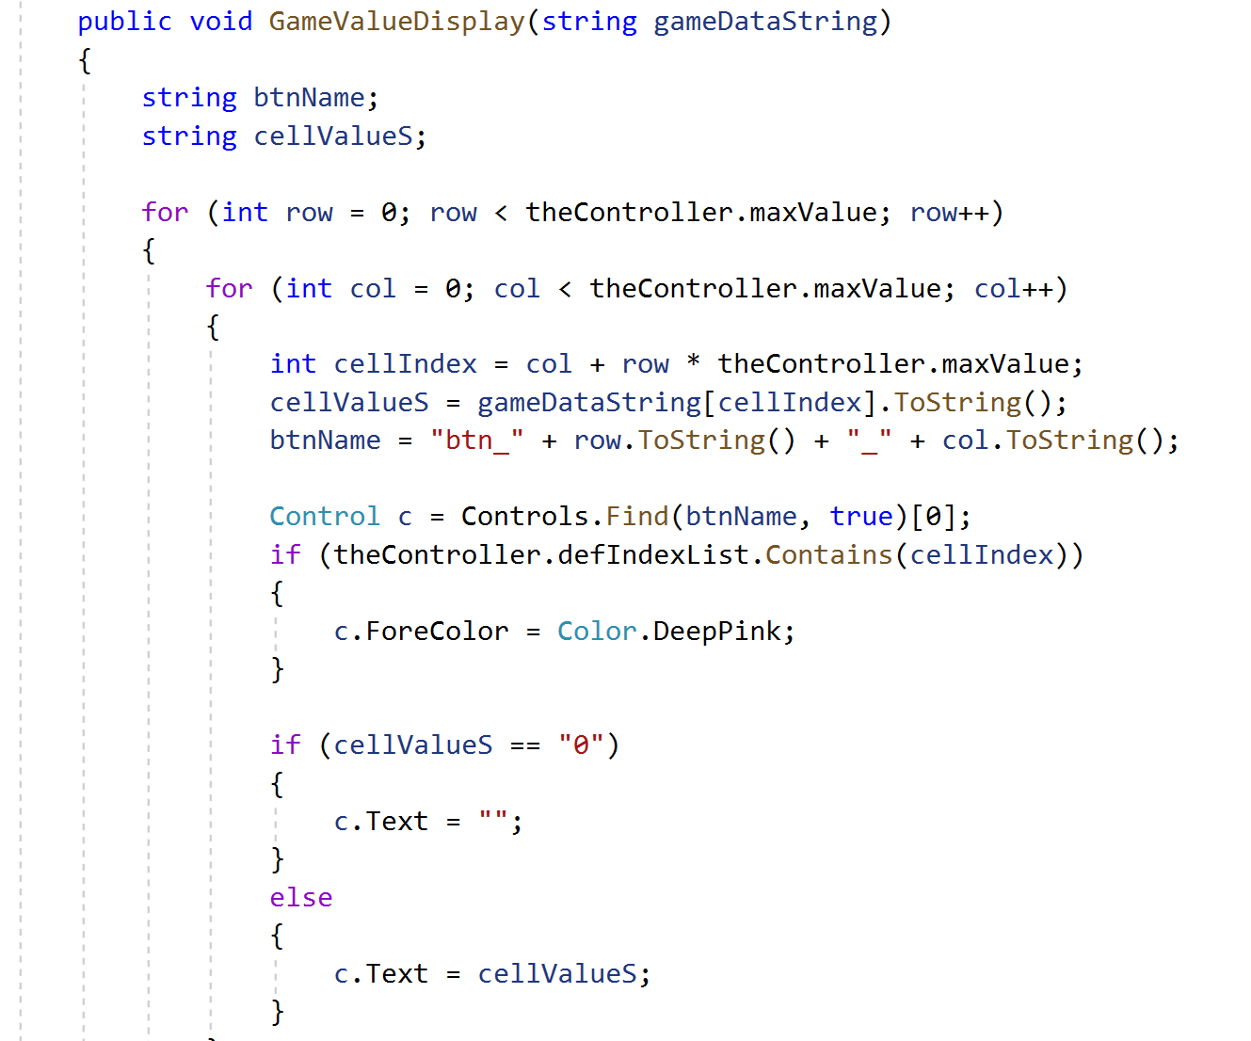
Feature 7: Do not override a default value
Code example from FormMain:
Display the default value in DeepPink color.

Slide 15
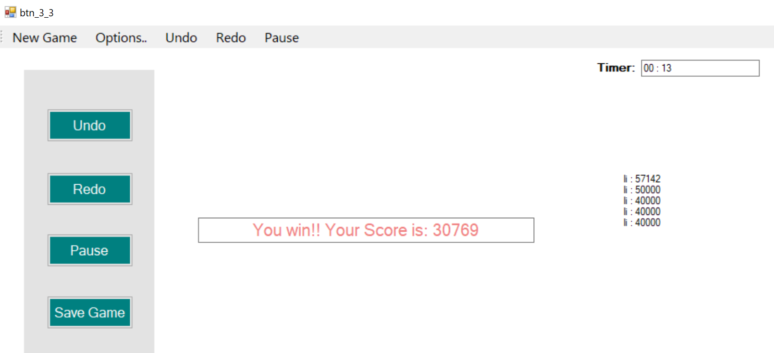
Feature 8: Show game complete
When the game is complete, the game board is hidden, and the user interface displays the game victory information and user scores. Timer stop .

Slide 16
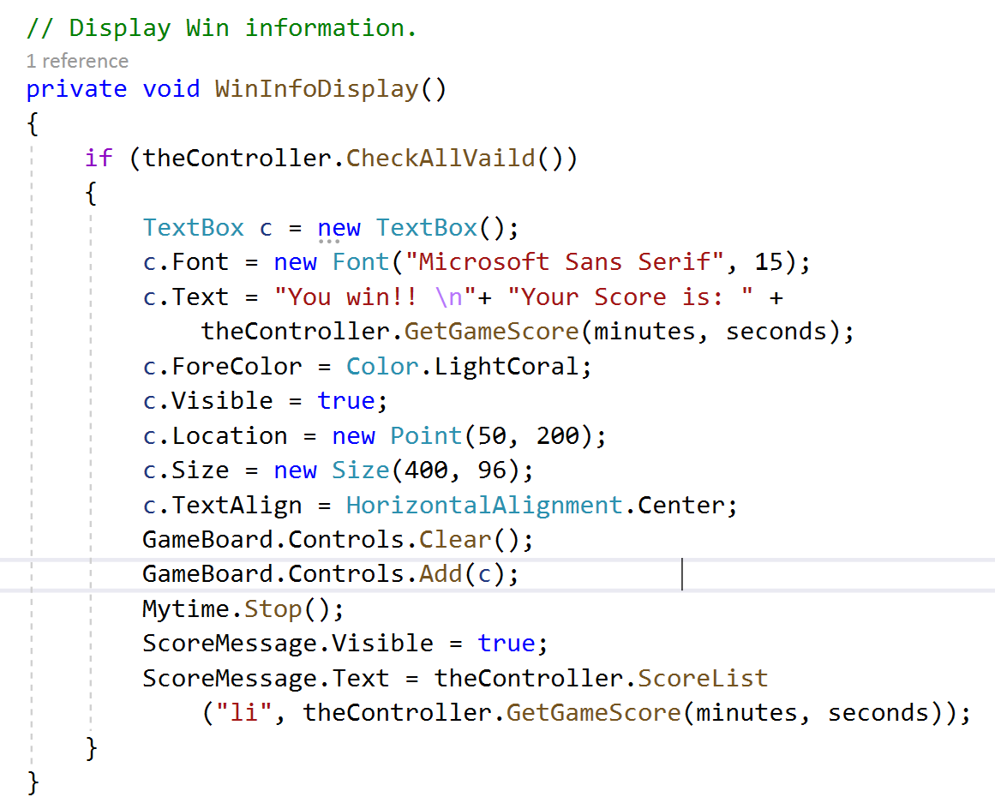
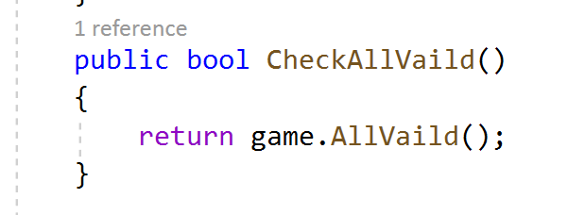
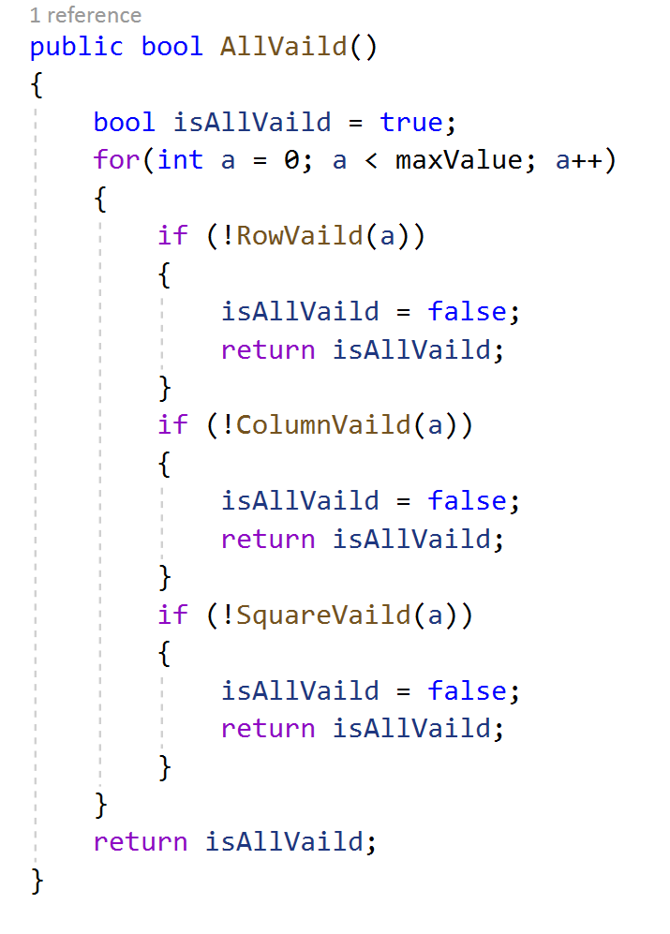
Feature 8: Show game complete
Code example from FormMain:
Code example from Controller:
Code example from Model:

Slide 17
Deliverables Part B
Feature 1: Save/Load partially played games
Feature 2: Design/Implement/Persist a scoring system for different levels
Feature 3: Undo/Redo feature
Feature 4: Hints for any square of all possible values
Feature 5: Hints for display all same values
Feature 6: X Sudoku, where the diagonals must also have the complete set of unique numbers.
Feature 7: Different methods (.TXT) of storing games that are not CSV.

Slide 18
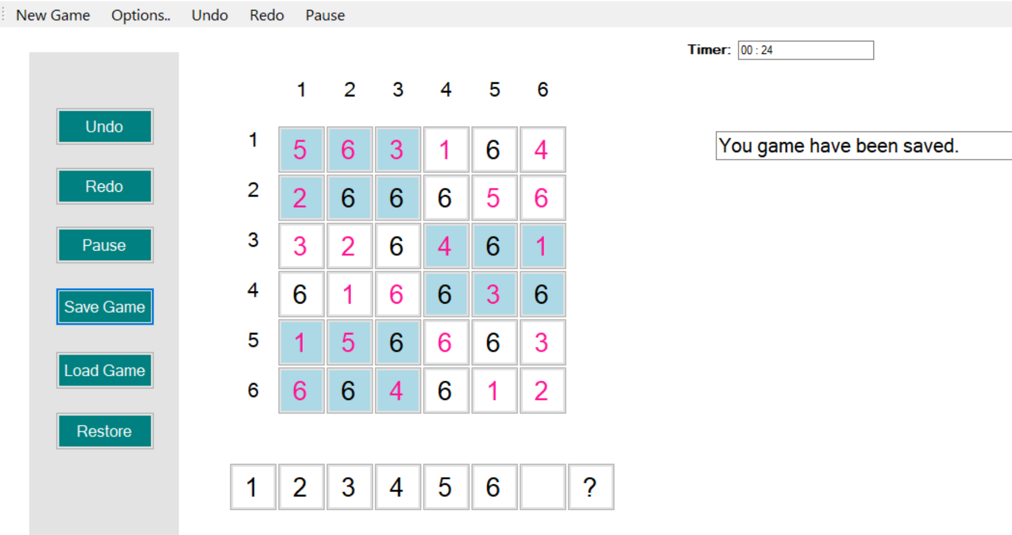
Feature 1: Save/Load partially played games
When user clicks the save game button, The system pop-up dialog asks the user to enter a filename. After the user enters the file name and confirms, the game data is stored.
Saved game information includes: maximum value of the game, square height, square weight, current value of the game, original default position of the game and game timing.
The game message indicates that the game has been saved.
Game message

Slide 19
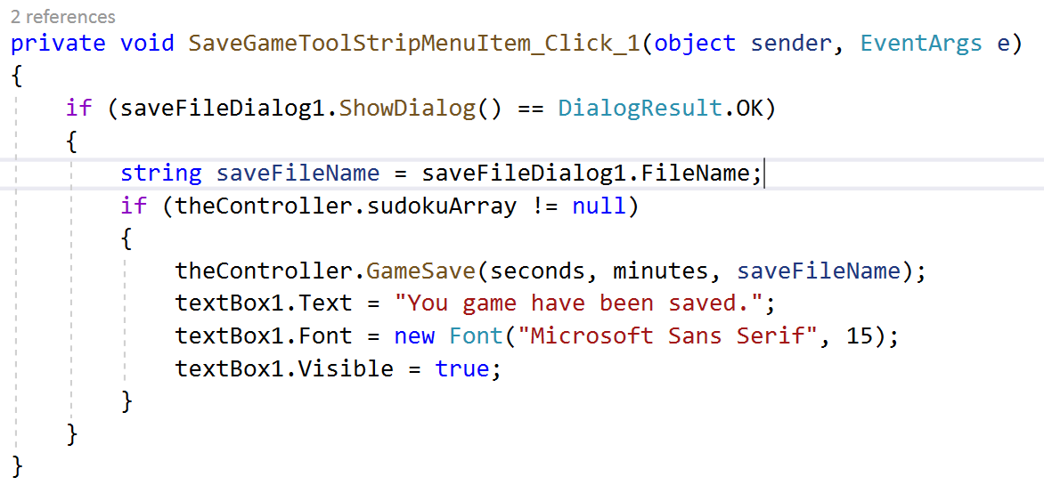
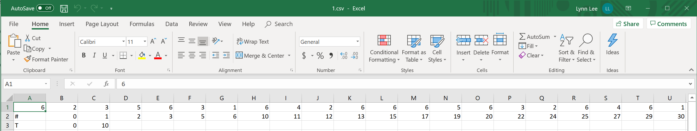
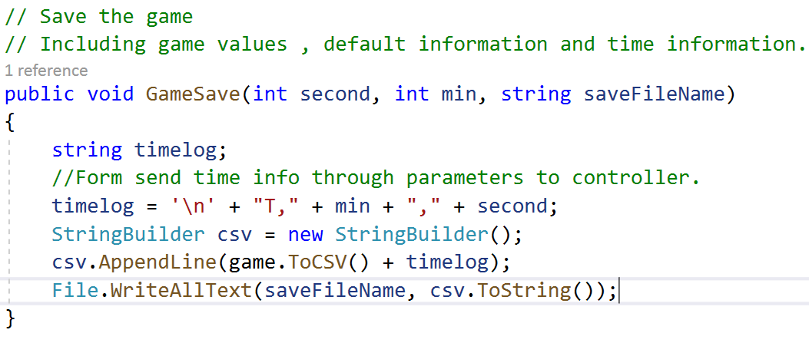
Feature 1: Save/Load partially played games
Code example from FormMain:
Game data have been save to an CSV file.
Code example from Controller:
After “T” is the time information
After “#” is original default value’s position
MaxValue/Square weight/Square height
Current value of the game

Slide 20
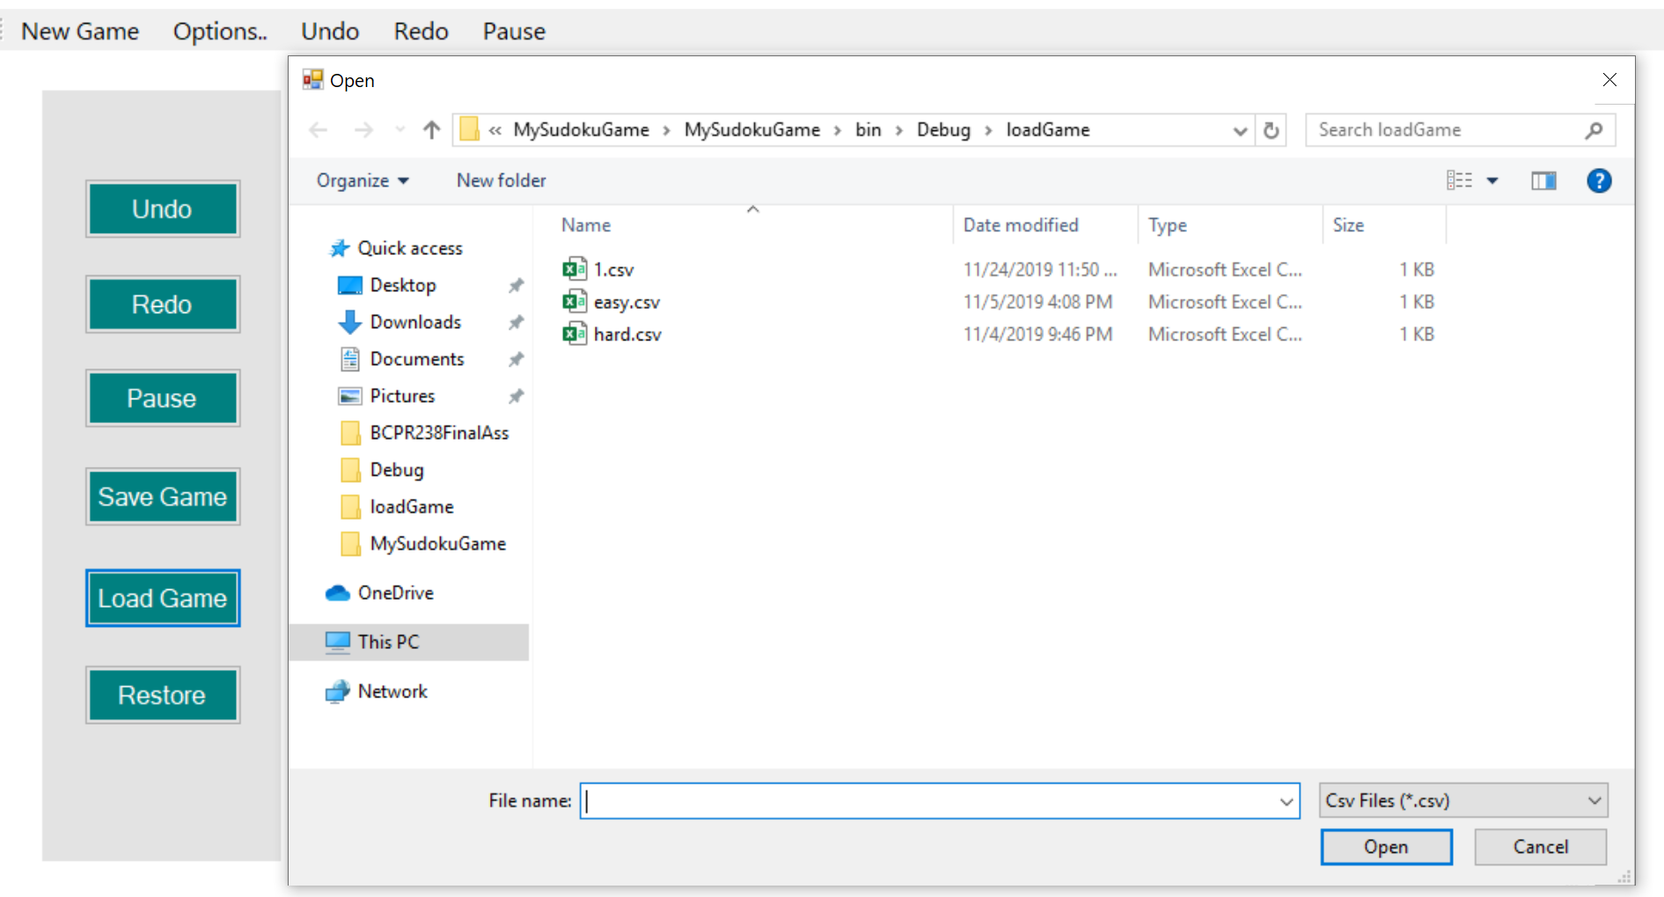
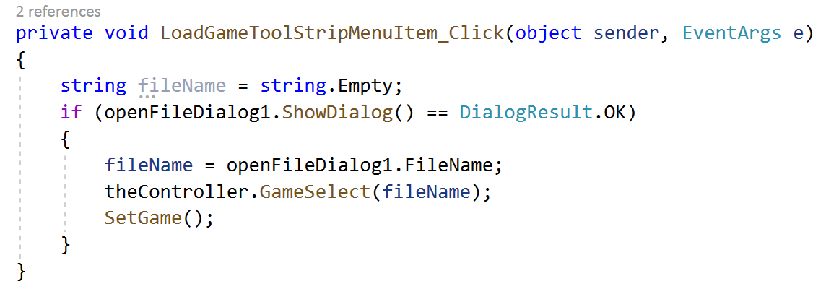
Feature 1: Save/Load partially played games
When the user clicks the load game button, the document dialog box for storing the game opens and the user can select the game to load.
When the game loads, both the default game location and time information are loaded.
Code example from FormMain:

Slide 21
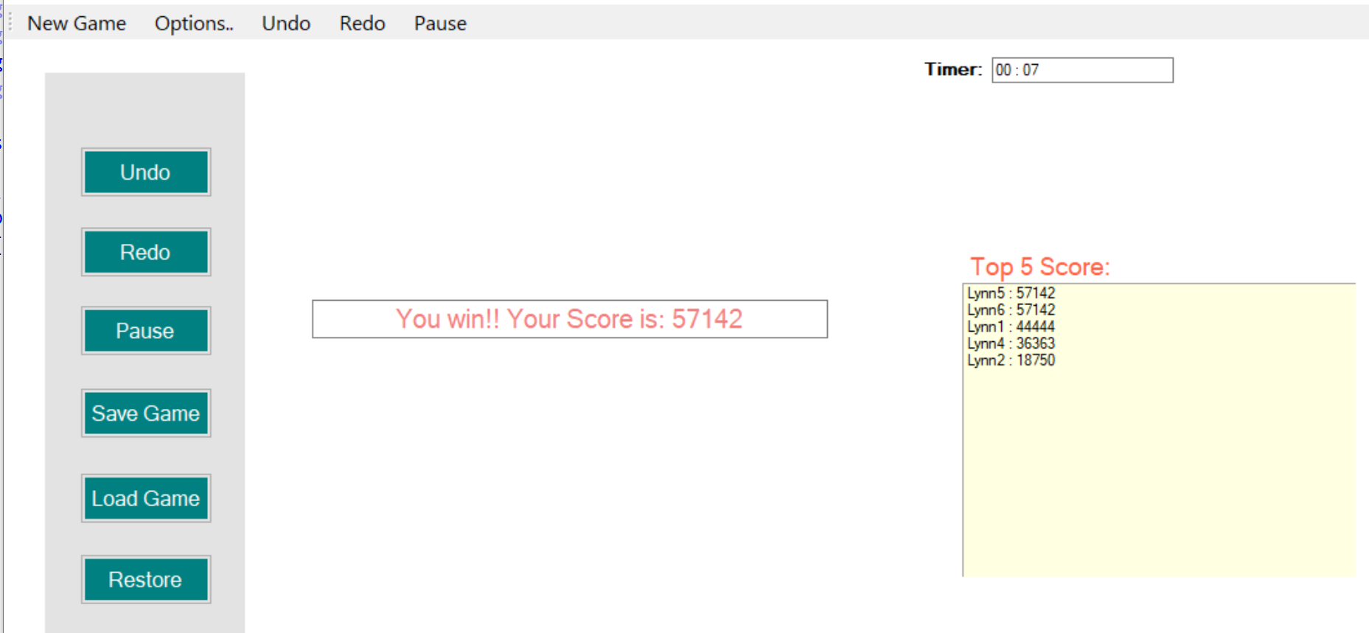
Feature 2: Design/Implement/Persist a scoring system for different levels
There is a scoring system for the game, which is related to the completion time of the game.
When the game is finished, a pop-up dialog asks the user to enter the user name.
The system will compares user scores to historical scores.
The score board of the game appears after the game is finished, listing the top 5 points in the game's history.

Slide 22
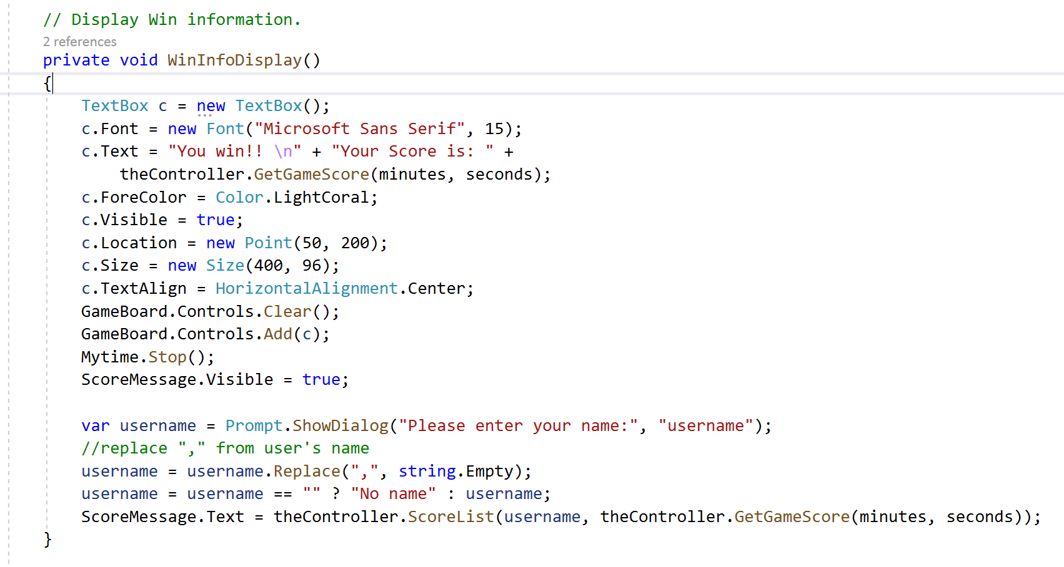
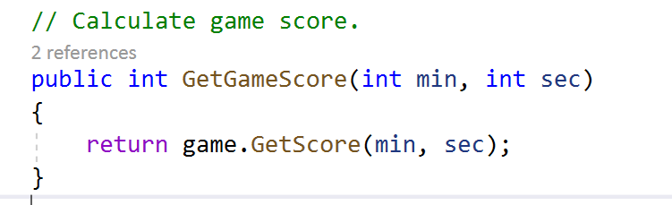
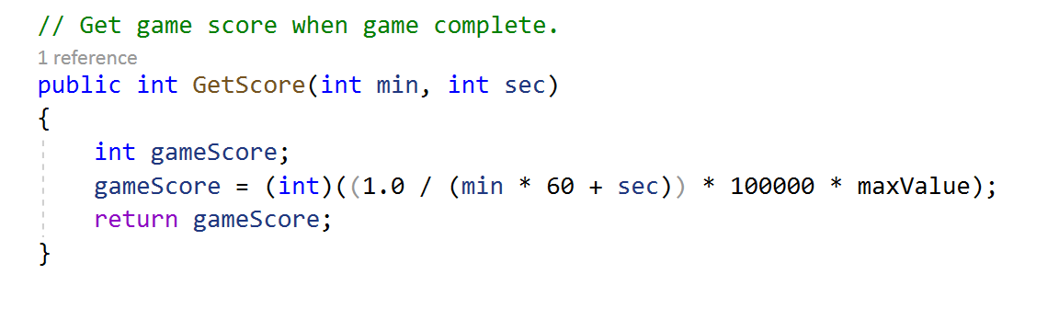
Feature 2: Design/Implement/Persist a scoring system for different levels
Code example from FormMain:
Code example from Controller:
Code example from Model:

Slide 23
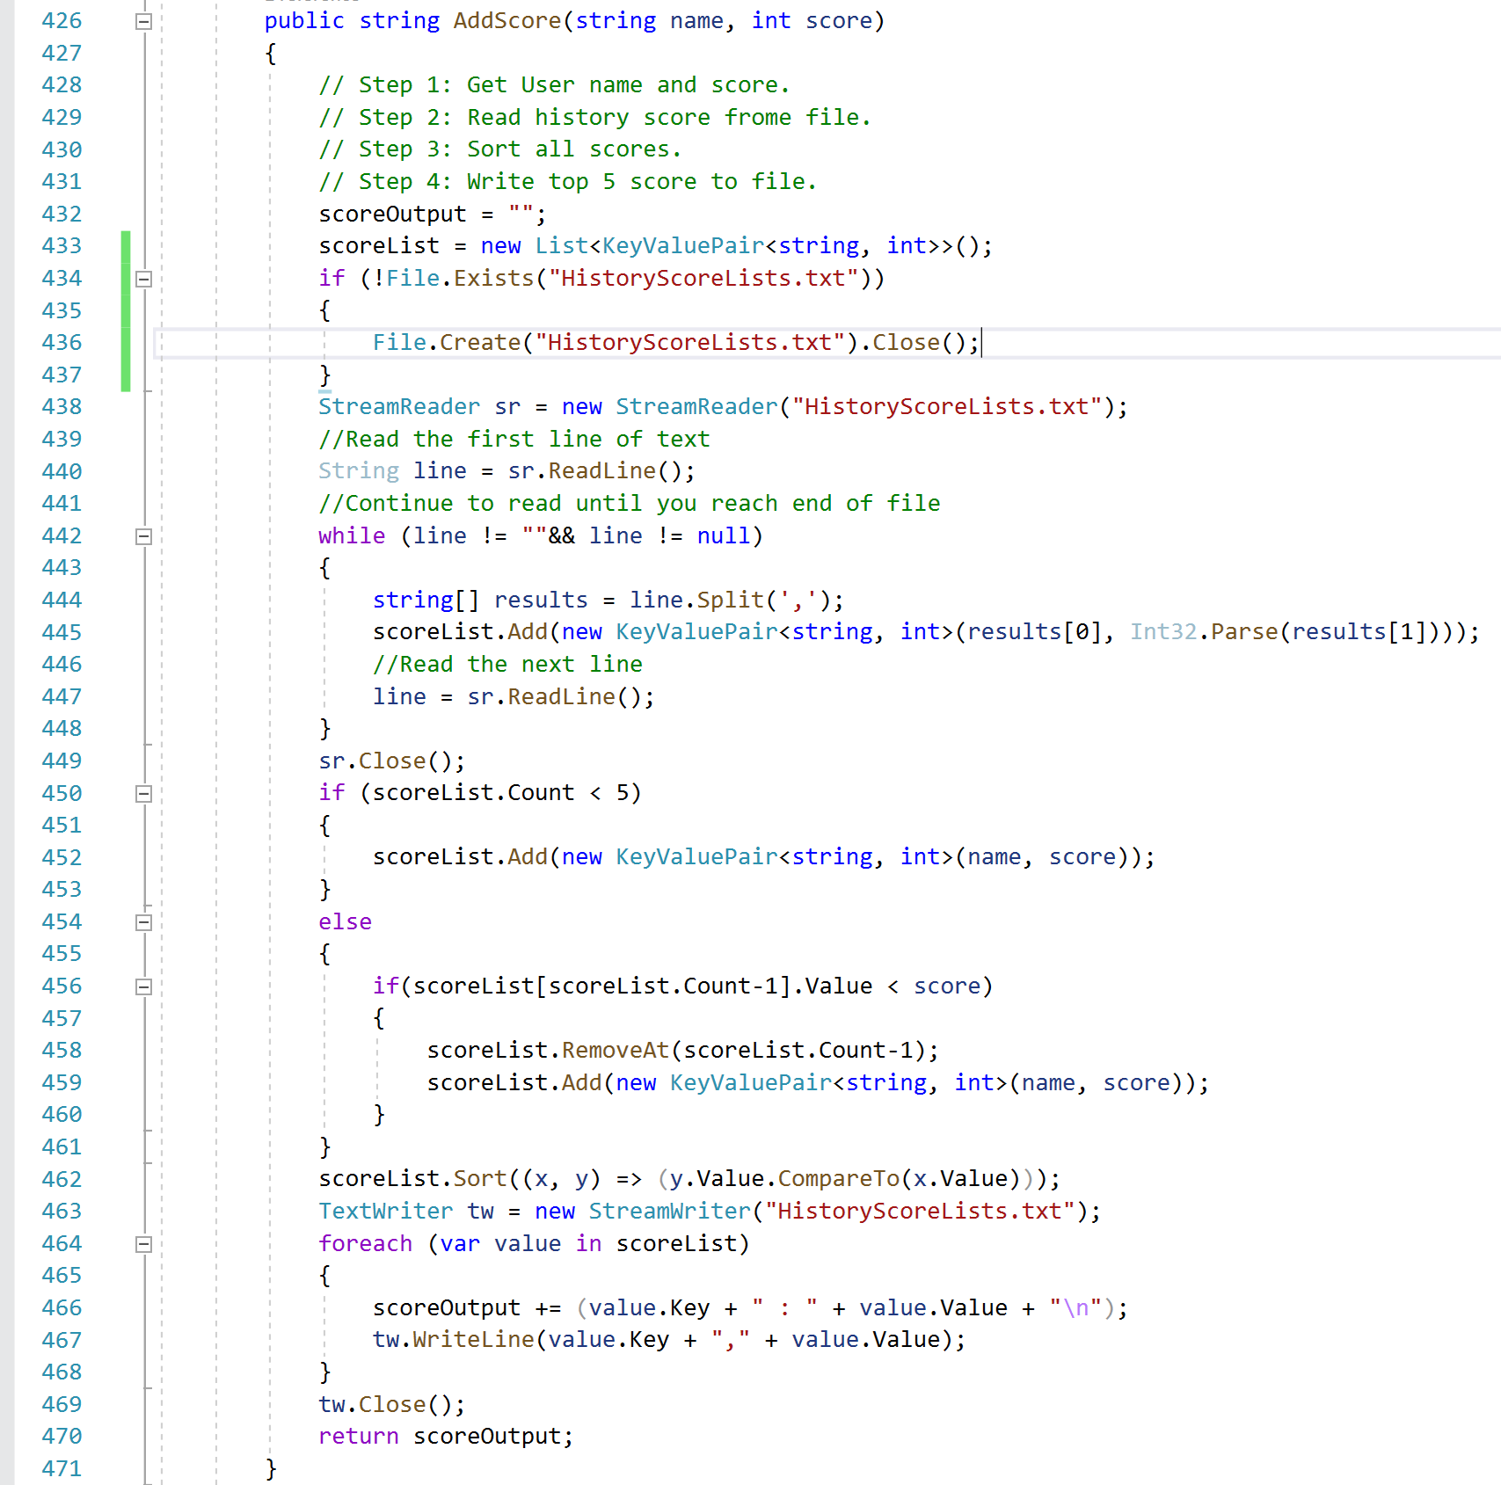
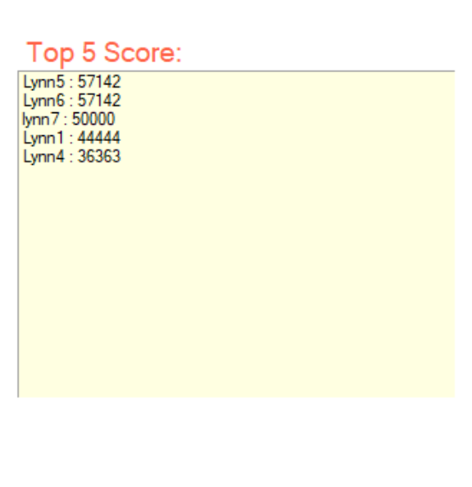
Feature 2: Design/Implement/Persist a scoring system for different levels

Slide 24
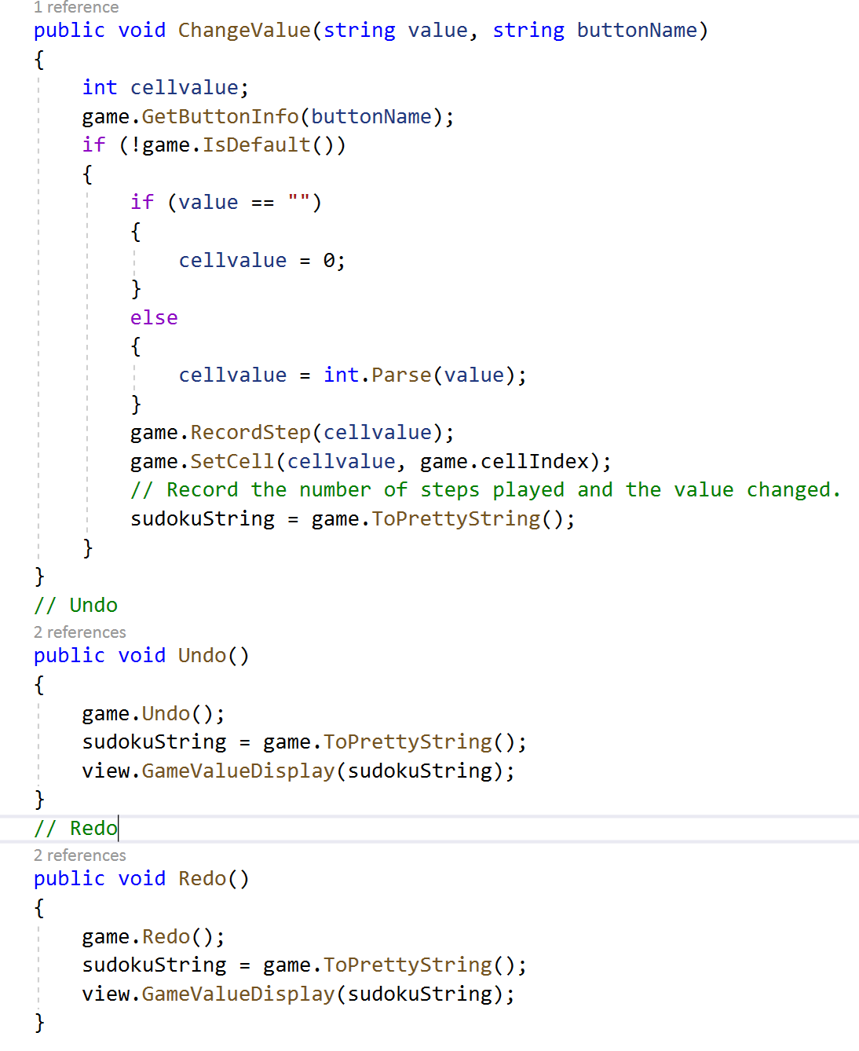
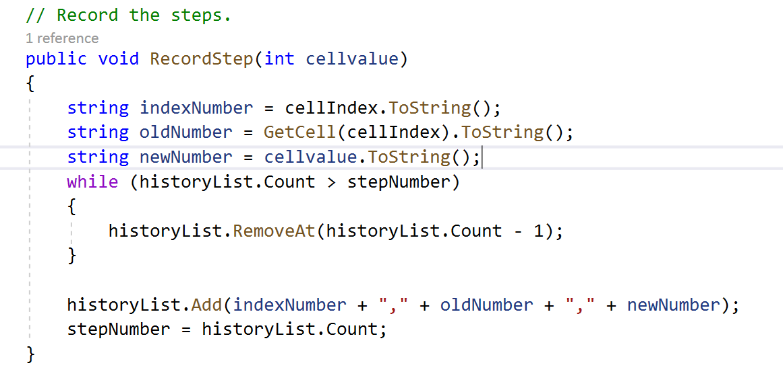
Feature 3: Undo/Redo feature
The game has undo and redo functions.
Undo and Redo functions allows the game to return to its original or final state step by step.
The step information be added to a string list called “historyList”
When the cell value be changed, this function is used to record step information.

Slide 25
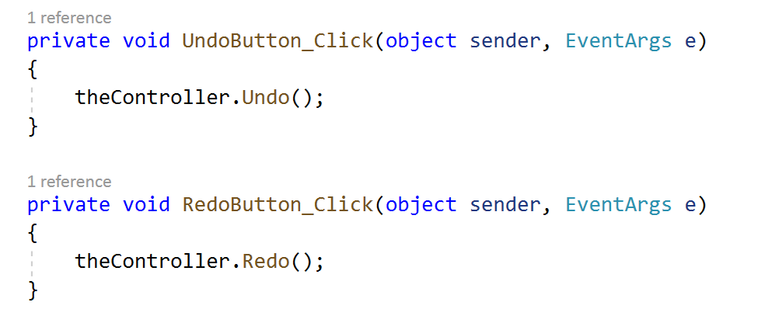
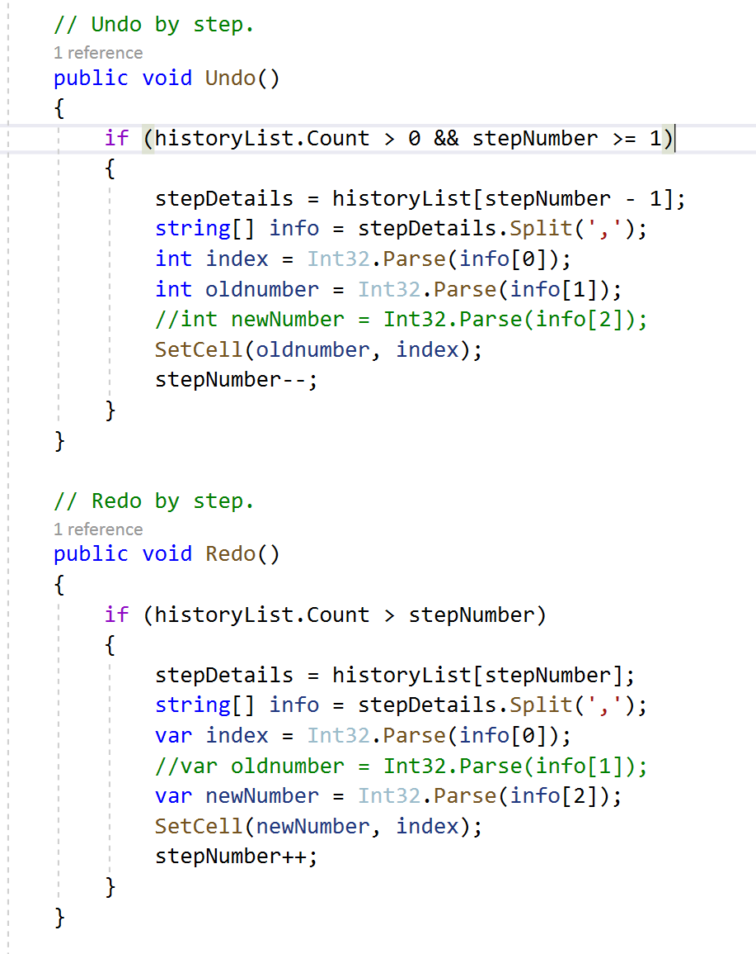

Feature 3: Undo/Redo feature
Code example from FormMain:
Code example from Model:
Code example from Controller:

Slide 26



Feature 4: Hints for any square of all possible values
Click "? "on the digital board. After that, you can get the game hint function, and then click on the blank cell in the game board. All possible values of the cell will be in pink color in the digital board.

Slide 27



Feature 4: Hints for any square of all possible values
Code example from FormMain:
Code example from Controller:

Slide 28

Feature 4: Hints for any square of all possible values
Code example from Model:

Slide 29


Feature 5: Hints for display all same values
Click "? "on the digital board. After that, you can get the game hint function, and then click on the cell with value in the game board. All values on the board that match this value will be rendered with a pink background.

Slide 30


Feature 5: Hints for display all same values
Code example from FormMain:
Code example from FormMain:
Code example from Controller:
Code example from Controller:

Slide 31

Feature 6: X Sudoku
User came play X sudoku game. If user wants to complete the game, they should not only make all the rows, columns, and squares complete, but also need to make the Numbers on the two diagonals match the requirements.
I designed different function to tell if the game was finished.
There is also has a function to show whether the diagonals completed.

Slide 32



Feature 6: X Sudoku
Step 1:Record the position of all the values on each diagonal into an int array.
Step 2: Determine whether the values on the two diagonals meet the requirements.

Slide 33



Feature 6: X Sudoku
Code example from FormMain:
Code example from Model:
Step3: Different from other ordinary games, X number has a unique function of judging whether the game is finished or not

Slide 34

Feature 7: Different methods (.TXT) of storing games that are not CSV.
When storing a file, the user can choose which type of document to store (.TXT or .CSV). The user can also select the type of document to read when loading the document.

Slide 35



Feature 7: Different methods (.TXT) of storing games that are not CSV.

Slide 36
Deliverables Part C
Theory 1: Design Patterns, Algorithms and programming language Idioms
Theory 2: Use appropriate software life-cycle models and software construction steps
Theory 3: Design programs
Theory 4: Design user interfaces which conform to recognized usability criteria
Theory 5: Code programs in the specified language using the prescribed standards
Theory 6: Produce and execute testing strategies at the systems level using a unit testing framework.
Theory 7: Debug and test programs to the systems level
Theory 8: Maintain existing programs and update documentation
Theory 9: Compare and contrast the features and uses of different programming languages

Slide 37



Q1: Design Patterns, Algorithms and programming language Idioms.
Theory One: MVC Design Pattern
Theory Two: SOLID Principles

Slide 38

Theory One: MVC Design Pattern
1.1.1 What is MVC Design Pattern
MVC is also known as Model-View-Controller. It divides the application into three parts that are dependent and connected to each other. (educba.com, n.d.)
Model - controls the logic and rules of application. It doesn’t contain any information on how to show the data to the user. It is independent of the user interface.
View - helps the user to see the model’s data. It is a visualization of information that the application contains.
Controller - provides the support for input and converts the input to commands for the application. It is used between the model and view part.

Slide 39
Theory One: MVC Design Pattern
1.1.2 Why MVC is a widely accepted theory ？
Today most of the applications follow this pattern. The MVC Design Pattern help in the reusing of code and parallel development. This makes working easier and simpler.
Some of the Top companies that use MVC Design Pattern are –
Microsoft
Go Daddy
Dell
Visual Studio
Wild Tangent
Ref : https://www.educba.com/what-is-mvc-design-pattern/

Slide 40
Theory One: MVC Design Pattern
1.1.3 What I Have Done ?
The sudoku game I designed used the MVC Design Pattern.
Model - Model included the main logic and algorithm of the game. The Model includes the functions of reading game information from CSV documents, transforming the game information into data types that can be displayed by the user interface, designing methods to obtain the value of sudoku games, designing methods to change the value of games, judging whether the games are completed and so on.
View - WinForms is used to display the game interface in Sudoku game. It inherits from IView and Form and plays the role of View in MVC structure. The main function of the WinForms is display the gameboard, inputs information to program and outputs information to user.
Controller - Controller is the control center of the whole program. It is like a bridge between View and Model to connect the whole program.

Slide 41





Theory One: MVC Design Pattern
1.1.4 Code Example

Slide 42
Theory One: MVC Design Pattern
1.1.5 Compare and Contrast
Compare with other possible approaches, this project use MVC has several advantages:
High reusability of code. Because the model is independent of the view interface, we can migrate a model to a new platform independently. All we need to do is make changes to the view and controller on the new platform.
High code maintainability. If we need to add and remove game functions, we only need to make changes in the model instead of making more changes to the view interface. If we need to improve the game interface, we only need to modify view. This greatly improves the efficiency of program development.
Shorten program development time. Using MVC mode in large development projects is conducive to the division of work of multiple developers and the improvement of development efficiency.
Disadvantage of MVC:
Using MVC in the development of small projects greatly increases the difficulty of development.

Slide 43


Theory One: MVC Design Pattern
1.1.6 The Effectiveness of My Approach
(Text-only interface)
(GUI interface)
Because the MVC is used in the development of the game, when the user changes the requirements of the game interface, the programmer can be quickly grafted from one interface to another without rewriting the entire game.
In practice, we reused the model, rewrite the user interface, and modify the whole program with a little adjustment to the controller.

Slide 44

Theory One: MVC Design Pattern
1.1.7 How Could I Improve?
In the existing software code, there are still some functions that can not be clearly defined, so some program logic is written into controller. In the later stage, I hope to make the function of each method more clear.
For example:

Slide 45
Theory Two: SOLID Principles
1.2.1 What is SOLID Principles
SOLID Principles is a coding standard that all developers should have a clear concept for developing software in a proper way to avoid a bad design. It was promoted by Robert C Martin and is used across the object-oriented design spectrum. When applied properly it makes your code more extendable, logical and easier to read.
S - Single Responsibility Principle :A class should have one, and only one, reason to change.
One class should only serve one purpose, this does not imply that each class should have only one method, but they should all relate directly to the responsibility of the class. All the methods and properties should all work towards the same goal. When a class serves multiple purposes or responsibility then it should be made into a new class.
O - Open-closed Principle : Entities should be open for extension but closed for modification.
Software entities (classes, modules, functions, etc.) be extendable without changing the contents of the class you’re extending. If we could follow this principle strongly enough, it is possible to then modify the behavior of our code without ever touching a piece of original code.

Slide 46
Theory Two: SOLID Principles
1.2.1 What is SOLID Principles
L - Liskov Substitution Principle : Subclass/derived class should be substitutable for their base/parent class.
It states that any implementation of an abstraction (interface) should be substitutable in any place that the abstraction is accepted. Basically, it takes care that while coding using interfaces in our code, we not only have a contract of input that the interface receives but also the output returned by different Classes implementing that interface; they should be of the same type.
I - Interface Segregation Principle : A Client should not be forced to implement an interface that it doesn’t use.
This rule means that we should break our interfaces in many smaller ones, so they better satisfy the exact needs of our clients.
Similar to the Single Responsibility Principle, the goal of the Interface Segregation Principle is to minimize the side consequences and repetition by dividing the software into multiple, independent parts.
D - Dependency Inversion Principle : High-level modules should not depend on low-level modules. Both should depend on abstractions. Abstractions should not depend on details. Details should depend on abstractions.
By applying the Dependency Inversion the modules can be easily changed by other modules just changing the dependency module and High-level module will not be affected by any changes to the Low-level module.

Slide 47
Theory Two: SOLID Principles
1.2.2 Reference
https://hackernoon.com/solid-principles-simple-and-easy-explanation-f57d86c47a7f
https://www.baeldung.com/solid-principles

Slide 48
Theory Two: SOLID Principles
1.2.3 What I Have Done ?
In my project, my code follow the Single Responsibility Principle. There. Class “Controller” is used to control the whole game. Class “SudokuGame” is used to store the main logic of the game. Class “ FormMain” is used to display the game.
We also follow the Interface Segregation Principle. This game have 5 separate Interface.
IGame for initialization purposes
IGet whare three main classic retrieves a cell value from a game board in various ways
ISet which sets a cell value into a game board in various ways
ISerialize which reads/writes values for a whole game board and implies knowledge of the way the data is stored, wither in CSV or in an appropriate class.
IView for the whole game display.

Slide 49




Theory Two: SOLID Principles
1.2.4 Code Example
Three main class:
Five separate Interface:

Slide 50
Theory Two: SOLID Principles
1.2.5 The Effectiveness of My Approach
Following the single responsibility principle makes my testing easier. With a single responsibility, the class will have fewer test cases. Less functionality also means less dependence on other classes. It leads to better code organization because smaller and more purposeful classes are easier to search.
Following the Interface Segregation Principle can make my program logic clearer and function implementation more flexible.

Slide 51
Q2: Use appropriate software life-cycle models and software construction steps.
Theory One: Prototyping Model
Theory Two: Software Life-cycle

Slide 52

Theory One: Prototyping Model
2.1.1 What is Prototyping Model
The prototyping model is a systems development method in which a prototype is built, tested and then reworked as necessary until an acceptable outcome is achieved from which the complete system or product can be developed.
This model works best in scenarios where not all of the project requirements are known in detail ahead of time. It is an iterative, trial-and-error process that takes place between the developers and the users.
In the development of this game, we mainly used Evolutionary prototyping model .

Slide 53
Theory One: Prototyping Model
2.1.2 Reference
Prototyping Model can solve the most urgent needs of users in a short time and complete a demonstrable product. This product is only part of the implementation (most important). Its most important purpose is to determine the real needs of users.
This method can obtain the user's requirements effectively in the actual development, so it is widely used in the process of software development.
Ref : https://searchcio.techtarget.com/definition/Prototyping-Model
https://melsatar.blog/2012/03/15/software-development-life-cycle-models-and-methodologies/

Slide 54


Theory One: Prototyping Model
2.1.3 What I Have Done ?
1. In the first stage of developing the program, the user’s requirement is to create a Sudoku game with C#. According to the requirement, we designed most of the logic of the game, and show it to users through the console interface.
2. In the last stage of the game development, the user give us some more detailed requirements, including the GUI interface of the game, the specific game functions they want to have, etc. After obtaining the precise needs of users, we continue to develop the game software.

Slide 55


Theory One: Prototyping Model
2.1.4 Code Example
First version of the program
Second version of the program
Improved according to user requirements

Slide 56
Theory One: Prototyping Model
2.1.5 Compare and Contrast
Compare with other possible approaches, prototyping model has several advantages:
1. Reduced time and costs, but this can be a disadvantage if the developer loses time in developing the prototypes.
2. Improved and increased user involvement.
Disadvantage of prototyping model :
1. Insufficient analysis. User confusion of prototype and finished system.
2. Developer misunderstanding of user objectives.
3. Excessive development time of the prototype.
4. It is costly to implement the prototypes.

Slide 57
Theory One: Prototyping Model
2.1.6 The effectiveness of my approach
If the game is developed according to the waterfall model, the game development results may not meet the real needs of users, or we will spend more time to revise the original game program.
2.1.7 How I Improved ?
In fact, we use MVC structure to develop game software, which solves the possible defects of prototyping model. It can not only quickly submit the prototype to the user, but also reduce the cost of modifying the program.

Slide 58
Theory Two: Software Life-cycle
2.2.1 Software Life-cycle
Here are 7 main stages of software development life cycle that should be followed by your development team.
Phase 1 – Brainstorming
This stage is also called planning as it generates the main requirements to the projects as well as creates a general roadmap. Planning is one of the most important phases of SDLC. It influences the whole development process and the ways everything will be done.
Phase 2 – Feasibility Analysis
Before investing heavily in the project, CEO and all team members have to carry out a feasibility analysis. The feasibility study can show how successful a project could be, evaluates all factors including economic and technical that affect the project development. Every member of the team, testers, developers, PMs, and others, must provide a clear estimate of time they need to complete their specific tasks, efforts and resources they need to involve. It will help calculate all expenses.

Slide 59
Theory Two: Software Life-cycle
2.2.1 Software Life-cycle
Phase 3 – Design
Conceptualizing the product is made on design stage of SDLC. Design is developed according to the specifications written during the first two stages. Designers, like any other architects, build the whole structure of the project and provide the final prototype that will be used for the next stages of development process.
Phase 4 – Programming
Here is coding where developers are getting started. Every programmer has his own task for coding for which he is responsible. The process of programming is controlled by project managers. This phase is the most time-consuming operation.

Slide 60
Theory Two: Software Life-cycle
2.2.1 Software Life-cycle
Phase 5 – Integration
Integrating of all sources and environments is a must in software development as it helps to figure out on time how many issues, conflicts, and bugs are there. Most teams, especially agile ones, use continuous integration. Such teams execute unit tests, use automated compilation and tests.
Phase 6 – QA
QA engineers test the quality of the code written by developers. They use different frameworks and kinds of testing to discover if there are any bugs in the system. Testers write test cases and report the bugs to developers to fix them.
Phase 7 – Release
First software release will be followed by the releases of next versions of the product. It is the final stage of development that can be also followed by maintenance and support.

Slide 61
Theory Two: Software Life-cycle
2.2.2 Reference
https://diceus.com/step-step-software-development-7-phases-build-product/

Slide 62
Theory Two: Software Life-cycle
2.2.3 What I Have Done ?
Brainstorming - Before the project started, I had a detailed understanding of the solitaire game. From the game designer, the game user, the game tester three aspects of the game function made assumptions and plans.
Feasibility Analysis - In this project, I mainly analyzed and considered which game functions could be realized, which steps could be realized, and the time required for the completion of the program.
Design - The design of this project is mainly reflected in the user interface design, program framework design, game flow design and so on. The design part takes up a large part of the program. Good design can make the later code process smoother.
Programming - Throughout the code, I followed the design and assigned weekly tasks.
QA - After I finished the project, I conducted unit tests and user experience tests to minimize program errors.
Release - This section also mainly includes maintenance of the program. I keep updating my program and optimizing my code before and after I submit my project.

Slide 63
Theory Two: Software Life-cycle
2.2.4 The effectiveness of my approach
In the process of making the sudoku game program, I had a complete experience of the software life cycle. Following this process, I can have a good understanding of how a program or software is produced and have a deeper understanding of the production of the program from different perspectives.
During this process, what impressed me most was the design part. In the process of learning code, most of us think about how to implement a function. Through this learning, we learned to think about how to build a program at a higher level.
2.2.5 How I Improved ?
From the beginning of the project, I was more concerned with how to implement a specific function of sudoku. As the project got bigger and more functional, I realized how important it was to build my own program. I still have a lot to improve on the structure of the program.

Slide 64
Q3: Design programs.
Theory One: Structural UML diagrams
Theory Two: Behavioral UML diagrams

Slide 65

Theory One: Structural UML diagrams
3.1.1 What is Structural UML diagrams ?
3.1.2 What I have done ?
Theory Two: Behavioral UML diagrams
3.2.1 What is Behavioral UML diagrams ?
3.2.2 What I have done ?
Summary: Structural UML diagrams & Behavioral UML diagrams
3.3.1 Compare and contrast
3.3.2 The effectiveness of my approach

Slide 66

Theory One: Structural UML diagrams
3.1.1 What is Structural UML diagrams ?
The structural diagrams represent the static aspect of the system. These static aspects represent those parts of a diagram, which forms the main structure and are therefore stable.
These static parts are represented by classes, interfaces, objects, components, and nodes.
In this program, we mainly used Class diagram.
Types of structural diagrams
Ref: https://www.tutorialspoint.com/uml/uml_standard_diagrams.htm
https://www.smartdraw.com/uml-diagram/
https://www.visual-paradigm.com/guide/uml-unified-modeling-language/behavior-vs-structural-diagram/

Slide 67

Theory One: Structural UML diagrams
3.1.2 What I Have Done ?
I made this class diagram for my first version of the game program.

Slide 68

Theory Two: Behavioral UML diagrams
3.2.1 What is Behavioral UML diagrams ?
Any system can have two aspects, static and dynamic. So, a model is considered as complete when both the aspects are fully covered.
Behavioral diagrams basically capture the dynamic aspect of a system. Dynamic aspect can be further described as the changing/moving parts of a system.
In this program, we mainly Sequence Diagram , Activity Diagram , Use Case, Structure Diagram
Types of behavioral diagrams
Ref: https://www.tutorialspoint.com/uml/uml_standard_diagrams.htm
https://www.smartdraw.com/uml-diagram/
https://www.visual-paradigm.com/guide/uml-unified-modeling-language/behavior-vs-structural-diagram/

Slide 69

Theory Two: Behavioral UML diagrams
3.2.2 What I Have Done ?
When I design the game , I use Behavioral diagrams to design the running process of the game.

Slide 70






Theory Two: Behavioral UML diagrams
The example of how I use the Behavioral diagrams.

Slide 71
Summary: Structural UML diagrams & Behavioral UML diagrams
3.3.1 Compare and contrast
Behavioral diagram shows how the system works ‘in motion’, that is how the system interacts with external entities and users, how it responds to input or event and what constraints it operates under.
Structure diagrams depict the static structure of the elements in your system. i.e., how one object relates to another. It shows the things in the system – classes, objects, packages or modules, physical nodes, components, and interfaces.

Slide 72
Summary: Structural UML diagrams & Behavioral UML diagrams
3.3.2 The effectiveness of my approach
Using Structural UML diagrams in the design phase gives me a more detailed and comprehensive understanding of the structure of the program. So that I can clearly understand the relationship between classes in the later code stage.
Using Behavioral UML diagrams can help me sort out the process of clear program, which is very helpful for the design of game process and specific game functions.

Slide 73
Q4. Design user interfaces which conform to recognized usability criteria.
Theory One: Visibility of system status
Theory Two: User control and freedom

Slide 74
Theory One: Visibility of system status
4.1.1 What is Visibility of system status
The visibility of system status refers to how well the state of the system is conveyed to its users. Ideally, systems should always keep users informed about what is going on, through appropriate feedback within reasonable time.
The ways to meet this standard are including let user to know the current system status, show appropriate feedback for a user action, Compel Users to Action, and so on.
The visibility of system status is a basic tenet of great user experience. At its core, this heuristic encourages open and continuous communication, which is fundamental to all relationships — whether with people or devices. Users who are uninformed about the system’s current status cannot decide what to do next in order to accomplish their goals, nor can they figure out if their actions were effective or if they made a mistake.
4.1.2 Reference
https://www.nngroup.com/articles/visibility-system-status/

Slide 75
Theory One: Visibility of system status
4.1.3 What I have done ?
I designed two navigation of the game, top and side menu, to adapt to users' different operation habits. Navigation bar keys clear indication, will not cause user ambiguity.
I designed different color Numbers to represent the default value of the game and the value that users can modify, so that users can easily understand the game information.
In the process of the game, I changed the color of the background and Numbers of the game to timely report the progress of the game to the users.
When the game is paused, the hidden board forces the user to click the button again to start the game.
When the game is over, the game interface is hidden and the victory message appears.

Slide 76



Theory One: Visibility of system status
4.1.4 Scan of design
Green numbers and areas are used to show valid row, col and square.
When the game is paused, the game time stops, the button’s text change to “continue”, and the game board is hidden. To start the game, the user must click the button again
The pink number represents the unmodifiable game default number, the black number represents the number that users can change it.
When the game is over, the game interface is hidden and the victory message appears..

Slide 77
Theory One: Visibility of system status
4.1.5 Theoretical summary
Compared with other possible approaches, designing a game user interface based on this theory allows users to have a clearer understanding of the state of the game.
The navigation bar is designed to allow users to quickly understand what the game has to offer. Without a status bar, users might be confused about how to play the game.
During the game, changing the color to show the effective area is more effective and intuitive than text output.
In addition, the state of the game in the pause and victory display, can let the user know the state of the game.
4.1.6 How could I improve.
In the next stage of game production, I will design more status tips to the user. Including game tips, score display, etc.

Slide 78
Theory Two: User control and freedom
4.2.1 What is User control and freedom
Users often choose system functions by mistake and will need a clearly marked "emergency exit" to leave the unwanted state without having to go through an extended dialogue. Support undo and redo.
4.2.2 Reference
https://www.nngroup.com/articles/ten-usability-heuristics/

Slide 79
Theory Two: User control and freedom
4.2.3 What I have done ?
Undo and Redo functions for the game. The user can undo the previous step at any time during the game. User can also use Redo's functionality to restore when the user undoes it in error.
Exit or Exit with save. When the user needs to interrupt the game, the user can choose to exit the game directly, or choose to save the game and exit.

Slide 80

Theory Two: User control and freedom
4.2.4 Scan of design
2
1

Slide 81
Theory Two: User control and freedom
4.2.5 Theoretical summary
These two functions allow the user to undo and restore the previous step at any time during the game. The two function keys are displayed in the menu bar and the sidebar, which clearly show the user the choices available.
4.2.6 How could I improve.
These features were not designed at the beginning of the game setup. However, when testing the game, I found without these two features, it would be very difficult to operate. So, I designed these two functions for the game. They make the whole game easier to play and more fun.

Slide 82
Q5. Code programs in the specified language using the prescribed standards.
Theory One: Naming Conventions
Theory Two: Commenting Conventions

Slide 83
Theory One: Naming Conventions
5.1.1 What is Naming Conventions?
Naming Conventions is a set of rules for choosing the character sequence to be used for identifiers which denote variables, types, functions, and other entities in source code and documentation. It relate to word choice, guidelines on using abbreviations and acronyms, and recommendations on how to avoid using language-specific names.
It is general including :Word Choice, Using Abbreviations and Acronyms, Avoiding Language-Specific Names, Naming New Versions of Existing APIs.
5.1.2 Reference
Ref : https://docs.microsoft.com/en-us/dotnet/standard/design-guidelines/general-naming-conventions

Slide 84
Theory One: Naming Conventions
5.1.3 What I have done ?
Use PascalCasing with namespace.
Did not use the same name for a namespace and a type in that namespace.
Did name classes and structs with nouns or noun phrases, using PascalCasing.
Did name interfaces with adjective phrases, or occasionally with nouns or noun phrases.
Did prefix interface names with the letter I, to indicate that the type is an interface.
Did ensure that the names differ only by the "I" prefix on the interface name when you are defining a class–interface pair where the class is a standard implementation of the interface.
Did name generic type parameters with descriptive names unless a single-letter name is completely self-explanatory and a descriptive name would not add value.
Use camelCasing in parameter names.

Slide 85



Theory One: Naming Conventions
5.1.4 Code Example
Example from <view> of class name, variable name, parameter names :
Example from <model> of class name, variable name, parameter names :
Example of Interface:

Slide 86
Theory One: Naming Conventions
5.1.5 Theoretical summary
Following the Naming Conventions in the process of completing this project has the following advantages:
Effectively avoid the occurrence of naming conflicts.
Reduce the work required to read and understand the source code.
Provide better understanding in case of code reuse after a long interval of time.
Enhance the aesthetic and professional appearance of work product.
Enable the use of automated refactoring or search and replace tools with minimal potential for error
5.1.6 How could I improve.
The names of some of the variables and parameters in the project should be clearer and more explicit.
Reduce the ambiguous naming.

Slide 87
Theory Two: Commenting Conventions
5.2.1 What is Commenting Conventions?
C# Coding conventions :
Place the comment on a separate line, not at the end of a line of code.
Begin comment text with an uppercase letter.
End comment text with a period.
Insert one space between the comment delimiter (//) and the comment text, as shown in the following example.
Do not create formatted blocks of asterisks around comments.
5.1.2 Reference
https://docs.microsoft.com/en-us/dotnet/csharp/programming-guide/inside-a-program/coding-conventions

Slide 88


Theory Two: Commenting Conventions
5.2.3 What I have done & Code Example
Example from <view>:
Example from <model>:
Add comments to each function.
If the logic is complex, add a comment to explain.

Slide 89
Theory Two: Commenting Conventions
5.2.4 Theoretical summary
Comments are like memos in the programming process. Good comments must follow the Commenting Conventions. First, good comments make the program cleaner and easier to read.
Second, good comments can help programmers quickly understand program structure and function.
Finally, good comments facilitate late maintenance of the program.
5.2.5 How could I improve.
There are three problems with the comments in my code:
1.Some functions lack comments;
2. Some features add too many useless comments, making the code more difficult to read.
3. The program commented out during the test forgot to delete, making the code look bloated and complicated.
During code maintenance, I fixed most of the bug comments. At present, there are still some invalid comments in my code, and I will continue to correct them in the later maintenance.

Slide 90
Q6. Produce and execute testing strategies at the systems level using a unit testing framework.
Theory One: Unit test
Theory Two: Test data

Slide 91

Theory One: Unit testing
6.1.1 What is Unit testing?

Slide 92
Theory One: Unit testing
6.1.2 Reference
Ref : https://docs.microsoft.com/en-us/visualstudio/test/unit-test-your-code?view=vs-2019
6.1.3 What I have done ?
In assignment part A, I used the testing tools in visual studio to unit test the logical part of my program.

Slide 93




Theory One: Unit testing
6.1.4 Code Example

Slide 94
Theory One: Unit testing
6.1.5 Evaluate the effectiveness of your approach.
Unit test combined with test plan can cover the whole program comprehensively.
Making a good unit test can save the test time and reduce the repeated editing of test code.
When I changed the existing functionality to develop features, these unit testing really reduces defects in the newly developed coding because they can verify the accuracy of expected results.

Slide 95
Theory One: Unit testing
6.1.6 Compare and Contrast
Compare with other possible approaches, unit testing has several advantages:
1. Unit test is a good way to manage test cases. There are five or six test cases for a function and many functions for a module to test. When you write unit tests, you don't need to create another file to store test cases separately.
2. Unit testing makes developer’s work easier. Good unit test design greatly reduces the time you spend debugging.
3. Unit tests can quickly locate program errors.

Slide 96
Theory Two: Test data
6.2.1 What is Test data ?
Test data is actually the input given to a software program. It represents data that affects or is affected by the execution of the specific module. Some data may be used for positive testing, typically to verify that a given set of input to a given function produces an expected result. Other data may be used for negative testing to test the ability of the program to handle unusual, extreme, exceptional, or unexpected input. Poorly designed testing data may not test all possible test scenarios which will hamper the quality of the software.
6.2.2 Reference
https://www.guru99.com/software-testing-test-data.html

Slide 97
Theory Two: Test data
6.1.3 What I have done ?
Test data is a set of inputs used to test the given features of the program, which includes both the positive and negative one. Positive data is used to test the function with an expected result (such as the valid parameters/variables), while negative data is used to test with the unexpected input (such as the invalid value with variables).
I check that my program logic is correct by entering test data. Check whether the game prompt meets the requirements by entering a specific value. In Unit test, I also use test data to check whether my operation is correct by inputting test array.

Slide 98


Theory Two: Test data
6.1.4 Code Example
Test data use for Console test.
Test data use for unit test.

Slide 99
Theory Two: Test data
6.1.5 Evaluate the effectiveness of your approach.
Well designed test data can better cover the scene, It help me quickly identify and correct serious defects in the program. Test data is also an indispensable part of test plan and unit test.

Slide 100
Q7. Debug and test programs to the systems level.
Theory One: Debugging

Slide 101

Theory One: Debugging
7.1.7 What is Debugging
Defects as Opportunities
Debugging is the process of identifying the root cause of an error and correcting it. It contrasts with testing, which is the process of detecting the error initially.
Role of Debugging in Software Quality
Like testing, debugging isn’t a way to improve the quality of your software per se; it’s a way to diagnose defects. Software quality must be built in from the start. The best way to build a quality product is to develop requirements carefully, design well, and use high-quality coding practices. Debugging is a last resort.

Slide 102

Theory One: Debugging
The Scientific Method of Debugging
Gather data through repeatable experiments.
Form a hypothesis that accounts for the relevant data.
Design an experiment to prove or disprove the hypothesis.
Prove or disprove the hypothesis.
Repeat as needed.
7.1.2 Reference
CODE COMPLETE, McConnell.S, 535-562

Slide 103
Theory One: Debugging
7.1.3 What I have done ?
In the process of coding, I will observe the error list below visual studio. Error list will prompt me for program errors or warnings. Most of the format errors or minor errors will be corrected after reminding by Error list.
I also debug the program by setting breakpoints if I find that it is not working as expected during the test.
Sometimes I also test the program's output and return through the Console and GUI forms.

Slide 104

Theory One: Debugging
7.1.4 Code Example
I usually set up text boxes in the user interface to test the values that the function outputs or returns. In this example, the text item outputs the same value’s index in game value array.

Slide 105

Theory One: Debugging
7.1.4 Code Example
The red marker indicates error and the yellow marker indicates warning.
Error List：

Slide 106

Theory One: Debugging
7.1.4 Code Example
Use breakpoint：
When a program runs incorrectly, I set a breakpoint based on the error prompted, or on the function involved in the error. Setting breakpoints also allows me to see program flow and variable state during debug.

Slide 107
Theory One: Debugging
7.1.5 Evaluate the effectiveness of your approach.
Debugging helps me detect errors immediately during programming, which allows me to detect errors earlier, and makes the software development process stress-free and trouble-free. It provides the most useful information about the data structure and allows for simple interpretation. By debugging, I can avoid complex one-time test code, which helps me save time and effort in software development.

Slide 108
Theory One: Debugging
7.1.6 Compare and Contrast
Each of the above three methods of debug has its own advantages.
Using the error list can provide the fastest understanding of the errors and potential risks of the program. Double-click on the error listed in the error list to quickly locate the line of code that went wrong.
In most cases, error lists only locate errors and do not help developers understand why they occur. Using breakpoints to troubleshoot errors gives you a visual view of how the program works, where it terminates, and what the state of the variable is.
I use the form display to view the data output when the breakpoint layout is not clear enough to understand the function output.
Combined with the three methods, it can quickly and effectively troubleshoot errors.

Slide 109
Q8. Maintain existing programs and update documentation
Theory One: Version control

Slide 110
Theory One: Version control
8.1.1 What is Version control?
Version control systems are software that help you track changes you make in your code over time. As you edit to your code, you tell the version control system to take a snapshot of your files. The version control system saves that snapshot permanently so you can recall it later if you need it.
Without version control, you’re tempted to keep multiple copies of code on your computer. This is dangerous-it’s easy to change or delete a file in the wrong copy of code, potentially losing work. Version control systems solve this problem by managing all versions of your code but presenting you with a single version at a time.

Slide 111



Theory One: Version control
8.1.1 What is Version control?

Slide 112
Theory One: Version control
8.1.2 Reference
Ref : https://docs.microsoft.com/en-us/azure/devops/learn/git/what-is-version-control
https://git-scm.com/about/branching-and-merging

Slide 113

Theory One: Version control
8.1.3 What I have done ?
I use github for version management of my projects. Including the follow steps:
Step 0: Install git and create a GitHub account.
Step 1: Create a local git repository.
Step 2: Add a new file to the repository.
Step 3: Add a file to the staging environment.
Step 4: Create a commit.
Step 5: Create a new branch.
Step 6: Create a new repository on GitHub.
Step 7: Push a branch to GitHub.

Slide 114


Theory One: Version control
8.1.4 Code Example

Slide 115


Theory One: Version control
8.1.4 Code Example

Slide 116

Theory One: Version control
8.1.4 Code Example

Slide 117
Theory One: Version control
8.1.5 Evaluate the effectiveness of your approach.
Version control helps me manage the historical version of my project. It keeps the history of changes so that I can go back to the previous good version whenever I want. The history allows me to do basic work based on any version of the code, such as fixing bugs in previous versions.

Slide 118

Theory One: Version control
8.1.6 Compare and Contrast
While Git and SVN are both enterprise version control systems (VCS) that help with workflow and project management in coding, they do have their differences. The difference between Git and SVN version control systems is that Git is a distributed version control system, whereas SVN is a centralized version control system. Git uses multiple repositories including a centralized repository and server, as well as some local repositories. SVN does not have a centralized repository or server.
Git has a staging area. This just means that if you made 100 new changes to your code, you can break these 100 changes into 10 or 20 or more commits each with their own comments and their own detailed explanation of what just happened! Not only can you stage your commits out to logically display what changes were made, but you can also do patch staging that ask you if you want. You would use patch staging if you and a co-worker are both working on the same file and you only want to commit a particular function that you’ve worked on. You do a Git patch using “git add -p”.

Slide 119
Theory One: Version control
8.1.7 How could I improve.
Currently, I usually upload versions after completing a new feature. I can increase the frequency of uploads and keep more historical versions to add new features and debug.
In addition, when adding a new version, I can annotate it with a more explicit description to facilitate later version management and rollback.

Slide 120
Q9. Compare and contrast the features and uses of different programming languages
Theory One: C# vs Python

Slide 121
Theory One: C# vs Python
What is C#?
C# is developed by Microsoft and approved by the International Standards Organization (ISO). It is a modern and straight-forward language. C# was developed by Anders Hejlsberg and his team throughout the event of .Net Framework.
C# is intended for Common Language Infrastructure (CLI), which consists of the workable code and runtime setting that enables the use of assorted high-level languages on totally different pc platforms and architectures.
What is Python?
Python is an all-purpose taken, interactive, object-oriented, and high-level language. It was created by Guido van Rossum throughout 1985- 1990. Like Perl, Python ASCII text file is additionally out there beneath the antelope General Public License (GPL). Python is a high-level, taken, interactive and object-oriented scripting language. Python is intended to be extremely clear. It uses English keywords oftentimes wherever as different languages use punctuation, and it has fewer syntactic constructions than other languages.

Slide 122
Theory One: C# vs Python
Difference Between Python vs C#
Both Python and C # are object-oriented languages, but the most distinction is C # which is totally object-oriented. C # is a statically compiled language. It is a modern and straight-forward language. C# is managed by the Microsoft Company. Python is a high-level, taken, interactive and object-oriented scripting language. Python is intended to be extremely clear. Python is a dynamically interpreted language. Python is generally primarily based on open supply initiatives and community involvement. Python shines in rapid development time.

Slide 123

Theory One: C# vs Python
Advantages:

Slide 124

Theory One: C# vs Python
Advantages:

Slide 125

Theory One: C# vs Python
Python sample of my previous project:

Slide 126


Theory One: C# vs Python
C# sample of my project:

